Slide 1
CROSS-EXAMINATION EXAMINATION
To put or not to put?
Rose Khalilizadeh
Forbes Chambers
*all transcripts referred to are matters of public record. Names and case details changed, redacted or anonymised.

Slide 2
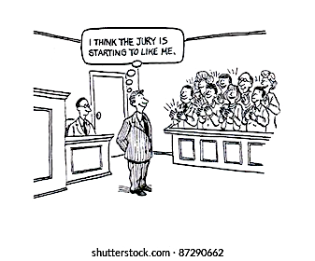

Slide 3
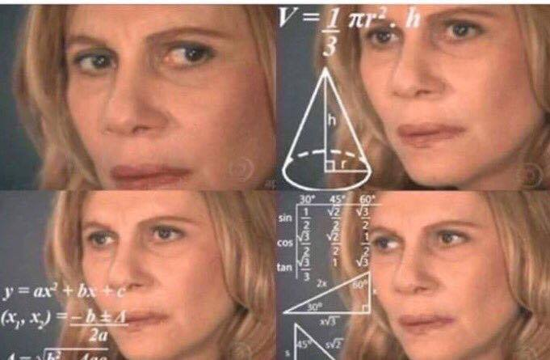

Slide 4
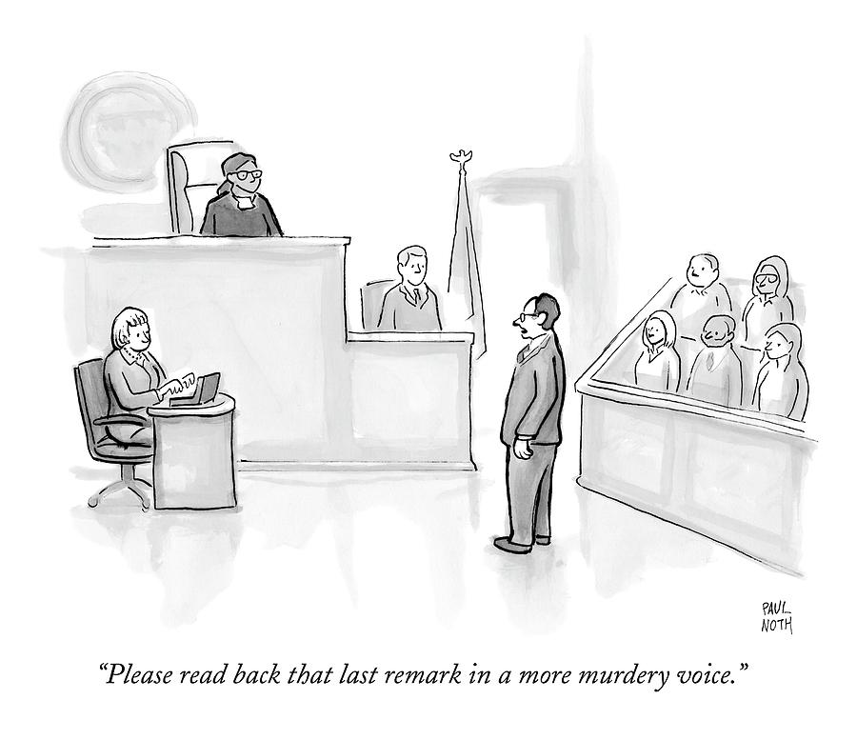

Slide 5
Younger’s “Ten Commandments” (…that we all should know by now)
Be brief
Ask short questions
Always ask leading questions
Do not ask a question to which you do not know the answer
Listen to the witness’ answers
Do not argue with the witness
Do not allow the witness to repeat their evidence in chief
Do not permit the witness to explain their answers
Do not ask one question too many
Save the ultimate point for your closing address

Slide 6
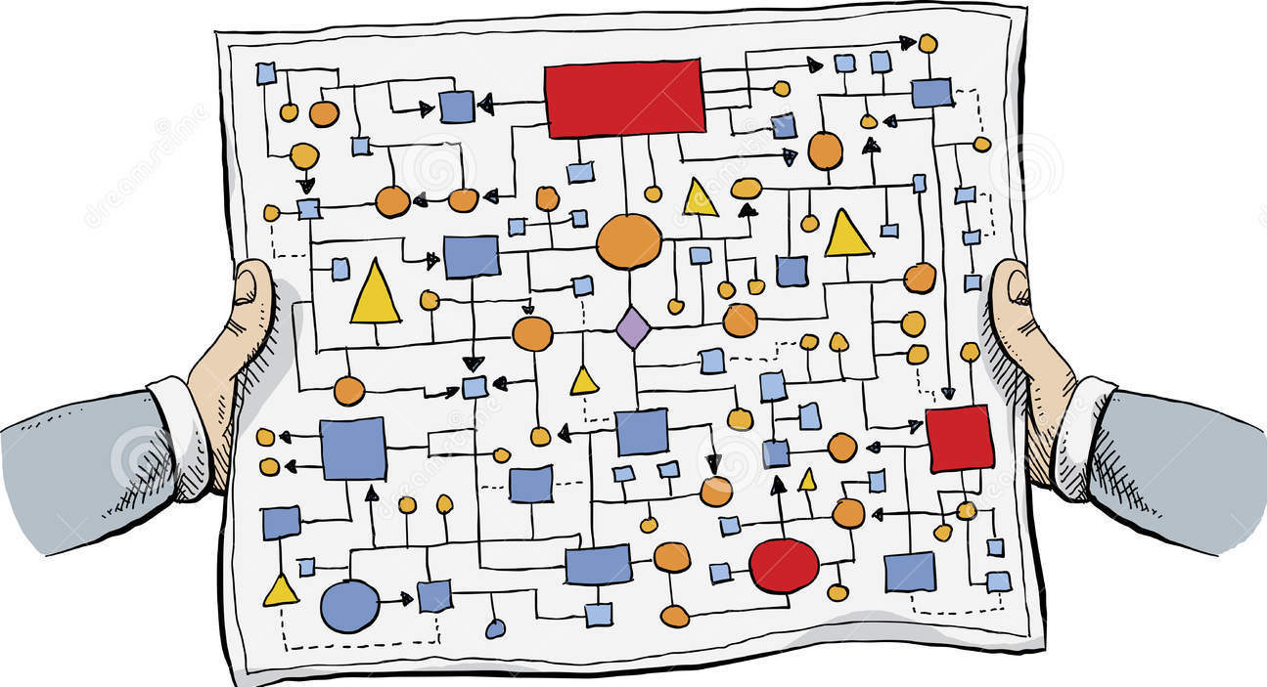
Pitfall 1: constraining your cross

Slide 7
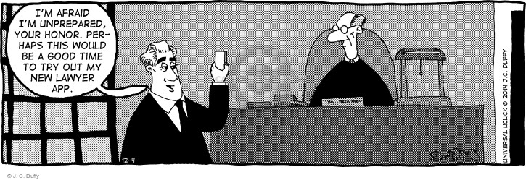
Pitfall 2: not being prepared

Slide 8
Multiple witnesses giving evidence about the same incident
 | Witness 1 | Witness 2 | Witness 3 | Witness 4
Where the fight started | Next to the tables in the courtyard | Next to the tables in the courtyard | In the doorway to the courtyard | Just inside the pub near the doorway to the courtyard
How many people were involved | 5-6 | 5 | 4 | 5-6
What the main aggressor looked like | Male, grey hoodie, 180cm tall, black shorts | Male, grey jumper, “tall”, not sure what else wearing | Male, black jumper, 180cm, black cap | Male, grey jumper, tattoo on neck

Slide 9
One witness – multiple statements
 | Statement 1.6.2020 | Statement 8.9.2020 | Statement 14.1.2021
What the main aggressor looked like | Male, grey hoodie, 180cm tall, black shorts [4] | Could have been wearing a backwards cap [11] | [nothing in statement]
What the main aggressor said during the fight | [nothing in statement] | [nothing in statement] | “The male said ‘I’m going to smash you into an A4 piece of pedigree’” [3]
How the fight ended | “I didn’t really see how it all ended” [8] | “The guy in the backwards cap just said ‘I’m done’ and left” [11] | “Everyone just went their separate ways and the guy in the grey hoodie ran to the carpark” [8]

Slide 11
Pitfall 3: not listening

Slide 12
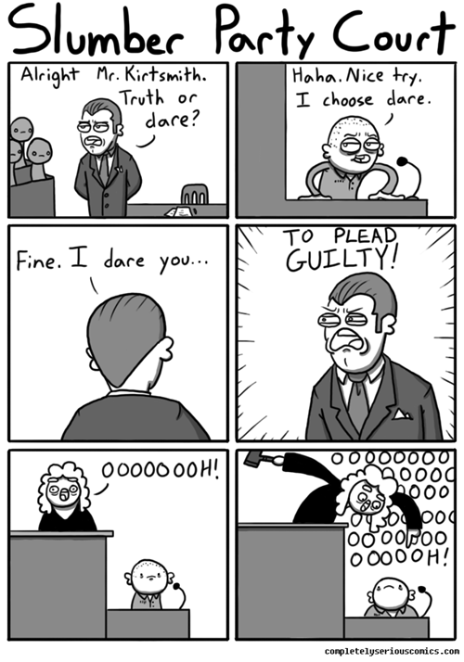
Pitfall 4: not controlling the witness

Slide 13
WITNESS: I'd rather just walk away because I'm - I'm just going to lose it.
HIS HONOUR: Mr Smith, it's quarter to 4. At this stage--
WITNESS: I'd rather let him out (pointing to the accused in the dock). Let him out. It's all good.

