Slide 1
Private Lawyer Quality Standards (PLQS) Unit
June 2021

Slide 2
What we do
The Private Lawyer Quality Standards (PLQS) Unit
Panels
Quality management;
      Proactive monitoring
      Responsive monitoring
Notes:
We manage the panels of private lawyers who do legally aided work
And monitor the quality of work being provided both proactively and responsively

Slide 3
Panels
Total panel members: 1461
Summary crime | 1079
Child crime | 488
Indictable crime | 593
Family law | 618
Care & Protection | 305
ICL | 124
Domestic violence | 503
Civil Law | 277
Mental Health | 348
Appellate Criminal Barrister | 89
Complex Criminal Barrister | 194
Indictable Criminal Barrister | 357
Notes:
But first, panels.
This is a snapshot of the current number of panel members on each of our panels.
This is a high number which reflects the amount of work that the private profession undertakes for legal aid.
Your work equates to around 70% of our ongoing casework and about 40% of our duty work.
You would all be aware by now that our panels applications processes have been streamlined.
Excluding the Appellate Barrister Panel (which has recently reopened), there is a single application form for all panels.
Our panels are now open for new applications year round.
Membership is rolling, meaning there is no longer a requirements to reapply to a panel you have already been appointed to.

Slide 4
Quality management
Proactive monitoring
      Informed by our Quality Priorities
      Developed annually to observe trends in quality of services
      Determine the areas of focus for the upcoming year for both audits and training
      To inform the Audit Targeting Plan for the upcoming year

Slide 5
Quality Priorities
      ICL panel
      3 regional areas;
        Grafton
        Moree
        Far South Coast
Notes:
The ICL Panel is the focus of our audit targeting plan over the next 12 months. Of the 133 Law Practices on the ICL Panel, 40 have been selected for file reviews to be undertaken. These files are reviewed against our Quality Standards to ensure compliance, identify concerns or issues that can be addressed.
The 3 regional areas were selected as legal aid either don’t have a great presence in the region or do not have a presence at all
We visit these areas and meet with various stakeholders to gauge any concerns relating to the legally aided work being conducted to identify any supports or issues that we can address
We have been to Grafton and Moree already and are scheduled to visit the far south coast in July.

Slide 6
Proactive monitoring
        File reviews
        Regular reports
        Data analysis
        Spot check audits
Notes:
File reviews conducted, informed by Quality Priorities
Regular reviewing of data on panel member activity
Data analysed for quality issues
Data considered in the context of the Quality Priorities
Spot check audits based on financial trends

Slide 7
Responsive monitoring
        Responding to complaints received or serious issues raised regarding Panel Member Law Practice’s or Associates undertaking legal aid work
        Robust complaints handling processes to ensure procedural fairness

Slide 8
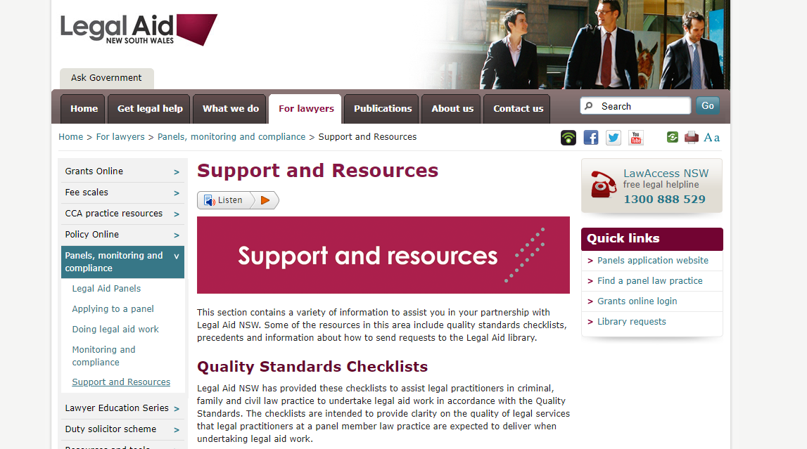
Support and resources

Slide 9
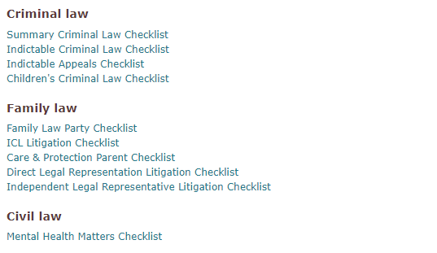
Support and resources
Checklists

Slide 10
Support and resources
Summary Crime Checklist
Attending Court
Conferencing clients
Court appearances
Appearing in EAGP matters as an agent
After a duty appearance
After a duty day
Notes:
Example of what is included in the summary crime checklist.
Really valuable resources that can be used by new or experienced practitioners to ensure all aspects of your matter has been covered.

Slide 11
Support and resources
Library assistance
Help to locate documents including;
  Cases
  Legislation
  Second reading speeches
  JIRS statistics
  Send your request to the library by emailing illuminlegalaid@softlinkillumin.net

Slide 12
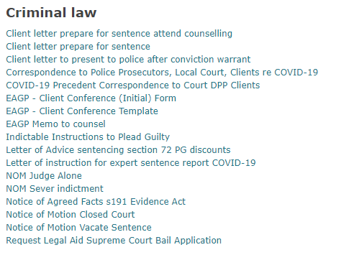
Support and resources
Precedents
Notes:
Also many for family law, care and protection, child support, ICL matters.

Slide 13
Support and resources
Videos
Freely available legal resources
Grants online
Fee scales
Means test
Eligibility for;
  Crime
  Family
  Civil
Notes:
‘Bite sized’ 10 minute videos to provide practical assistance and guidance on each area
Legal resources video provides step by step guidance and freely available legal information including cases, legislation, extrinsic materials, commentary. Options that do not require a paid subscription.

Slide 14
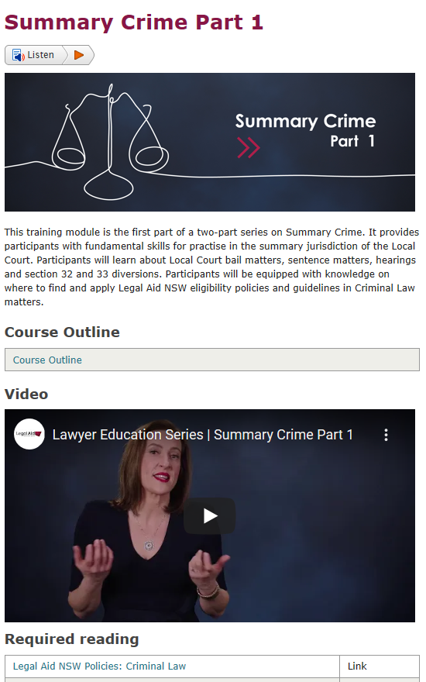
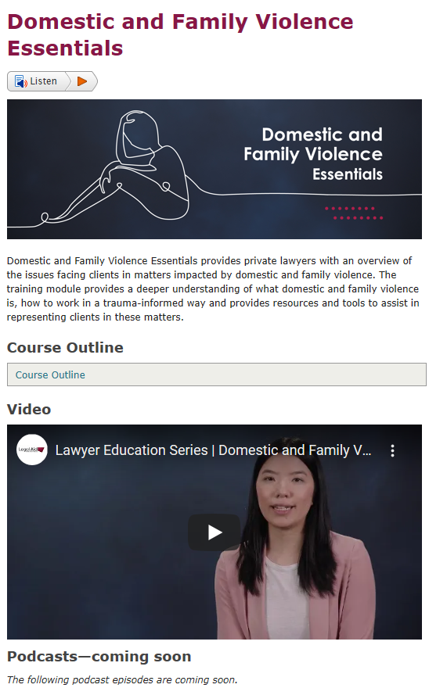
Lawyer education series
Notes:
Each module includes a video, podcasts, and useful resources including checklists and guides

Slide 15

Lawyer education series
Current available training modules

Slide 16
Lawyer education series
Coming soon
Summary Crime Part 1
Children’s Crime
Urgent Parenting Matters
Family Dispute Resolution: A guide to representing clients
Indictable Crime

Slide 17
PLQS Unit
Contact details
Panels:
  panels@legalaid.nsw.gov.au
Complaints:
  PLQS.complaints@legalaid.nsw.gov.au
Any other enquiries:
  PLQS.unit@legalaid.nsw.gov.au

