Slide 1
Acknowledgement of Country
We at Justice Health, acknowledge all Aboriginal and Torres Strait Islander Traditional Custodians of Country and recognize their continuing connection to land, sea, culture and community.
We pay our respects to Elders past, present and emerging.

Slide 2
Taking your cue from the clues: Identifying mental illness and / or cognitive problems and how to communicate effectively
Ashanti Tong Dr Gordon Elliott
Clinical Nurse Consultant Consultant Forensic Psychiatrist
Professor David Greenberg
Consultant Forensic Psychiatrist

Slide 3
What is a Mental Illness?
“I have mental problems” “I see someone for mental issues” “I’m feeling a bit depressed”
As per the Mental Health Act 2007:
A condition that seriously impairs, either temporarily or permanently, the mental functioning of a person and is characterized by the presence in the person of any one or more of the following symptoms-
Delusions
Hallucinations
Serious disorder of thought form
A severe disturbance of mood
Sustained or repeated irrational behaviour indicating the presence of any one or more of the symptoms referred to in paragraphs (a) to (d)

Slide 4
Why is this so important?
1 in 5 Australians aged 16–85 experienced a mental disorder in the previous 12 months (ABS 2022).
The prevalence of mental illness and mental disorders is far higher in individuals who appear before the courts (Butler 2001).
Mental illness covers a range, including anxiety disorders, affective disorders, psychotic disorders and substance use disorders.
Many people struggle with their mental health.
It does not necessarily mean they have a mental illness.
However, a person does not need to meet the criteria for a mental illness or mental disorder to be negatively affected by their mental health.
Mental health is impacted by multiple socioeconomic factors, including a person’s access to services, living conditions and employment status.

Slide 5
Statistics at a glance:
Internationally the prevalence of serious mental illness in courts is approximately 7-10%
49% of inmates report a history of mental health treatment
Even higher for Aboriginal inmates - 80% of Aboriginal women and 66% of Aboriginal men had a mental illness
140,000 persons are charged with an offence in NSW annually (approximately 6,000 are young people)
Under the new NSW Mental Health & Cognitive Impairment Provisions) Act 2020, the Magistrate has the power to order a section 14 (community order) or a section 19 (hospital) thus diverting mentally ill defendants from the judicial system into the community for treatment in lieu of incarceration

Slide 6
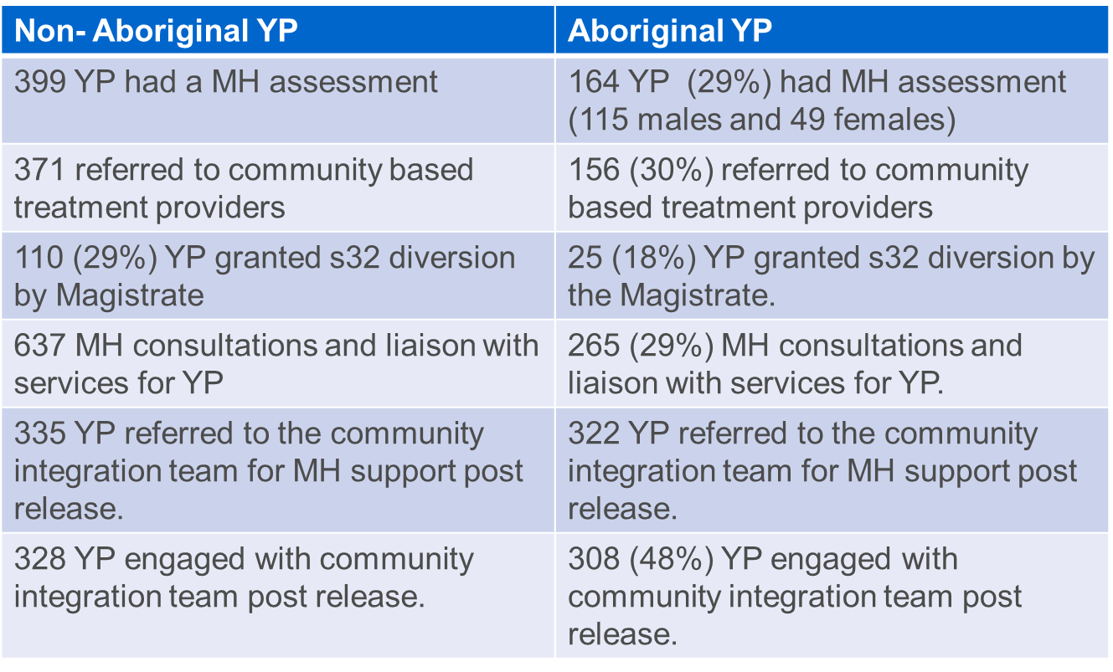
Outcomes for Young People (YP) in 2019/20

Slide 7
Broad types of psychotic presentations
1. Florid – agitated, manic, markedly thought disordered, obviously deluded and/or responding to hallucinations.
2. Guarded – quiet, suspicious, questioning of questions, denying any history of mental illness despite evidence to the contrary
3. chronic accommodated psychosis – entrenched fixed delusions and/or voices, features of chronic SCZ including self neglect, homelessness
4. first presentation psychosis - many different versions, but an absent history of care or treatment
5. residual – minimal to no psychotic symptoms, but obvious evidence of chronic schizophrenia including marked self neglect, minimal to no initiative or spontaneity, impoverished replies to questions, seeming indifference.
6. catatonic – seen less frequently now. Mute, holding odd posture

Slide 8
Clues for mental illness
History – of psychiatric hospital admissions, especially admissions longer than a week, of community mental health team contact, of community treatment orders, of antipsychotic treatment especially long acting injectable medications or an antipsychotic requiring regular blood tests/monitoring
If they tell you! OR refusing to talk about their mental health, declining consent to liaise with GP/ mental health team/ family
Mental state examination
Clues on appearance include disorganized or eccentric clothing, self neglect
Slowed thinking, pauses, distraction, apparent indifference, incongruence between emotional state and topic
Thought disorder – disjointed ideas, difficult to follow train of thought, rapid speech
Hallucinations and Delusions: Client is distracted, delayed responses, preoccupied with fixed false beliefs
Paranoia: suspicious, questioning your role, asking what you are noting down, darting eyes, whispering, quiet voice,
Concerning statements or actions: thoughts of self harm/ suicide; thoughts of harming others around them. Plan and/ or intent to act. Possession of means to act.
Mood: low mood to the point where they are not attending to basic daily care/ tasks,

Slide 9
Caution advised
If you’re feeling unsafe, you probably are.
Patients who are obviously mentally ill, but insist they are not and further insist they don’t need mental health care.
Manic patients – driven, fast talking, quick to become enraged
Paranoid patients – suspicious, questioning questions, incorporating you into their persecutory beliefs
Those with marked substance intoxication or withdrawal. Ie agitated, restless, sweating, distracted or rapidly shifting focus of attention
History of aggression to health care workers

Slide 10
Interview tips for the psychotic client
Attempt to modify your environment (quiet space/ room or open outdoor space that protects privacy). Know where your duress is located. | Explain your actions (closing/ open door, note taking, reading facts)- could exacerbate paranoia/ anxiety
Speak in calm, slower but clear, simple terms | If possible, offer preference of speaking with male or female. With permission offer their support person to sit in.
Minimize distractions (mobile on silent) as could exacerbate paranoia/ anxiety | Acknowledge their distress but don’t’ empathize where you cannot “I can’t imagine but that must be a terrifying feeling”
Maintain regular eye contact (avert or lower your eyes as appropriate- particularly with Indigenous clients) | Out of custody- if you are concerned about their immediate safety (hurting themself or others), call an ambulance and advise them of this. If possible, provide the ambulance with their residential address in the case they leave. If immediate risk is not an issue, contact the Mental Health Line to refer the client and advise them of this.
Keep your hands visible | Avoid reinforcing a delusional belief. As part of your work, you must present them with the facts but if there is a delusion associated to the fact, avoid challenging it
Avoid judgmental or defensive attitude/ tone | Provide extra time for the interview
Interview tips (cues) for the psychotic client
Attempt to modify your environment (quiet space/ room or open outdoor space that protects privacy). Know where your duress is located.
Provide extra time for the interview
Minimize distractions (mobile on silent) as could exacerbate paranoia/ anxiety
Explain your actions (closing/ open door, note taking, reading facts)- could exacerbate paranoia/ anxiety
Keep your hands visible
Speak in calm, slower but clear, simple terms
Avoid judgmental or defensive attitude/ tone
Maintain regular eye contact
If possible, offer preference of speaking with male or female. With permission offer their support person to sit in.
Acknowledge their distress but don’t’ empathize where you cannot “I can’t imagine but that must be a terrifying feeling”
Avoid reinforcing a delusional belief. As part of your work, you must present them with the facts but if there is a delusion associated to the fact, avoid challenging it
Out of custody- if you are concerned about their immediate safety (hurting themself or others), call an ambulance and advise them of this. If possible, provide the ambulance with their residential address in the case they leave. If immediate risk is not an issue, contact the Mental Health Line to refer the client and advise them of this.

Slide 11
Clues for mental illness
It is the clinicians job to find out if the symptoms and behaviours are genuine or malingered in nature. Your main goal is to obtain as much information as possible from the client by ensuring they feel as safe and well supported as possible.
“There is a strange, entirely unfounded superstition even among psychiatrists that if a man simulates insanity, there must be something mentally wrong with him in the first place. As if a sane man would not grasp at any straw if his life were endangered by the electric chair” (Wertham, 1949).

