Slide 1

Psychology and Criminal Law: Making the best of an imperfect fit
- Legal Aid Conference 2023
Patrick Sheehan
Forensic Psychologist

Slide 2
Contents
Introduction
DSM-V- What’s new?
Personality Disorders
Briefing and instructions
Risk assessment in practice – critical analysis of reports
Rehabilitation and risk management
What happens after sentencing?

Slide 3
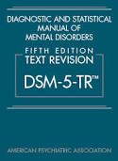
Diagnostic & Statistical Manual of Mental Disorders – 5-TR
Designed to assist clinicians in conducting clinical assessment, case formulation and treatment planning
Not designed to meet the technical needs of the courts and legal professionals
“These dangers arise because of the imperfect fit between the questions of ultimate concern to the law and the information contained in a clinical diagnosis” (DSM-V, p25)

Slide 4
Diagnostic Issues
Diagnosis is a hypothesis.
Differential diagnosis is not a weakness.
Retrospective diagnoses can run the risk of being speculative.
Updated version released in 2022.
Main changes are the literature base, some changes to the use of language, and and emphasis on cultural considerations.

Slide 5
New Additions:
Premenstrual dysphoric disorder.
Prolonged grief disorder.
Stimulant induced mild neurocognitive disorder.
Other changes:
Criterion A addition (clinical impairment and distress). added for Autistic Spectrum Disorder (ASD).

Slide 6
There is broad recognition that early trauma can affect people in enduring, complex ways that are not neatly captured within the DSM PTSD criteria.
Complex PTSD not in DSM.
Is in the International Classification of Diseases – 11th Revision (ICD-11R).
Risk of overdiagnosis?
Post Traumatic Stress Disorder (PTSD) vs Complex PTSD

Slide 7
What is Personality?
How we construct our world.
How we relate to people and ourselves.
Ingrained unquestioned habits.
Nexus to criminal behavior:
  Requires a formulation
  Often partial

Slide 8
Personality Disorder
Personality Disorders refer to long-standing, pervasive and inflexible patterns of behaviour:
  Depart from cultural expectations
  Impair social and occupational functioning
  Cause emotional distress

Slide 9
Personality Disorders: Facts and Statistics
Prevalence of Personality Disorders:
  About 0.5% to 2.5% of the general population
  Rates are higher in inpatient and outpatient settings
  Higher again in offender populations
Origins and Course of Personality Disorders:
  Nature/nurture debate
  Thought to begin in childhood
  Tend to run a chronic course if untreated
Co-Morbidity Rates are High.

Slide 10
Dangers of Diagnosis:
  Single exposure assessment
  Fundamental Attribution Error (Ross, 1977)
  - Cultural bias

Slide 11
Personality Disorder Clusters
Personality disorders fall into three general clusters:
  Persons in cluster A seem odd or eccentric
    Paranoid, schizoid, schizotypal
  Persons in cluster B seem dramatic, emotional or erratic
    Antisocial, borderline, histrionic, narcissistic
  Persons in cluster C appear as anxious or fearful
    Avoidant, dependent, obsessive-compulsive

Slide 12
Odd/Eccentric Cluster
Paranoid personality disorder (PD) involves suspicion of others, hostility, jealousy:
  No hallucinations and no full-blown delusions are present in paranoid PD.
Paranoid PD occurs more frequently in men than in women.
Lifetime prevalence is about 1 percent.

Slide 13
Odd/Eccentric Cluster
Schizoid personality disorder (PD) involves:
  Reduced social relations and few friends.
  Reduced sexual desire and few pleasurable activities.
  Indifference to praise or criticism.
  Lonely lifestyle.
Prevalence of schizoid PD is less than 1 percent and occurs more commonly in men than women.

Slide 14
Odd/Eccentric Cluster
Schizotypal personality disorder (PD) involves:
  An attenuated form of schizophrenia:
    Odd beliefs and magical thinking
    Recurrent illusions (things not present)
    Ideas of reference (hidden meaning)
    Behavior and appearance is eccentric
Prevalence of schizotypal PD is about 3 percent and occurs slightly more commonly in men than women.

Slide 15
Dramatic/Erratic Cluster
Borderline personality disorder (BPD).
Prevalence of BPD is approx. 1-2 percent and occurs more commonly in women than men.

Slide 16
Diagnostic criteria BPD
A pervasive pattern of instability of interpersonal relationships, self image, and affects, and marked impulsivity, beginning by early adulthood and present in a variety of contexts, as indicated by five (or more) of the following:
Frantic efforts to avoid real or imagined abandonment.
A pattern of unstable and intense interpersonal relationships characterized by alternating between extremes of idealization and devaluation.
Identity disturbance: markedly and persistently unstable self-image or sense of self.
Impulsivity in at least two areas that are potentially self-damaging (spending, sex, substance abuse, reckless driving, binge eating).

Slide 17
Diagnostic criteria BPD cont.
Recurrent suicidal behavior, gestures or threats, or self-mutilating behavior.
Affective instability due to marked reactivity of mood (e.g. intense episodic dysphoria, irritability, anxiety lasting for hours, not days.
Chronic feelings of emptiness.
Inappropriate and intense anger or difficulty controlling anger (e.g., frequent displays of temper, constant anger, recurrent physical fights).
Transient, stress-related paranoid ideation or severe dissociative symptoms.

Slide 18
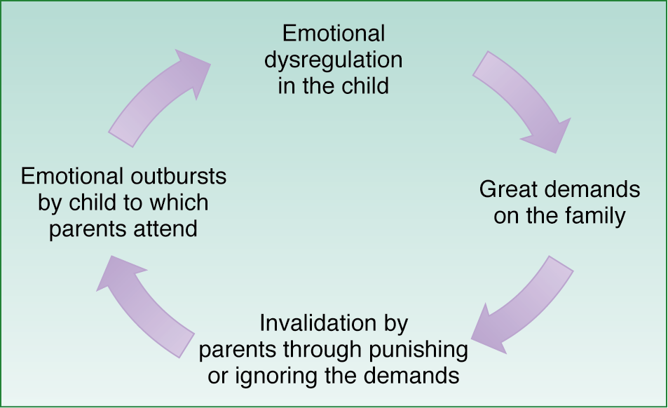
Linehan’s Diathesis-Stress theory: Etiology of borderline personality disorder
Emotional dysregulation in child (diathesis) and a failure to validate the child’s feelings by the parents (stress) leads to a vicious cycle.
The emotional dysregulation may be inadvertently reinforced by parents if it becomes one of the only times the child receives parental attention.

Slide 19
Dramatic/Erratic Cluster
Narcissistic personality disorder (PD) involves:
  A grandiose view of the person’s own importance
  A strong sense of entitlement
  A lack of empathy for others
Overblown but fragile ego, easily punctured.
Prevalence of narcissistic PD is less than 1 percent and this disorder co-occurs with borderline PD.

Slide 20
Dramatic/Erratic Cluster
Antisocial personality disorder (APD):
  Prevalence of antisocial PD is about 3% of men and 1 % of women.
  Course is chronic but tends to “burn out” in middle age.

Slide 21
Diagnostic criteria
A pervasive pattern of disregard for and violation of the rights of others, occurring since aged 15 years, as indicated by three (or more) of the following:
Failure to conform to social norms with respect to lawful behaviours, as indicated by repeatedly performing acts that are grounds for arrest.
Deceitfulness, as indicated by repeated lying, use of alias, or conning of others for personal profit or pleasure.
Impulsivity or failure to plan ahead.
Irritability and aggressiveness, as indicated by repeated physical fights or assaults.

Slide 22
Diagnostic Criteria APD Cont.
Reckless disregard for safety of self or others.
Consistent irresponsibility, as indicated by repeated failure to sustain consistent work behaviour or honor financial obligations.
Lack of remorse, as indicated by being indifferent to or rationalizing having hurt, mistreated or stolen from others.
The individual is aged at least 18 years.
There is evidence of conduct disorder with onset before age of 15 years; and
The occurrence of antisocial behaviour is not exclusively during the course of schizophrenia or bipolar disorder.

Slide 23
Etiology of Antisocial PD
Family issues may play a role in the development of antisocial PD:
  Lack of affection.
  Severe parental rejection; and
  Inconsistent (or no) discipline.
Twin studies show a greater concordance for antisocial PD in MZ twins relative to DZ twins.
Adoption studies (e.g., Cadoret et al., 1995):
  Adverse adoptive environment may be the stressor triggering the ASPD biological diathesis.
Psychopaths:
  Have reduced grey matter in frontal lobes.
  Perform more poorly on tests of frontal lobe functioning; and
  These findings are supportive of a key role for impulsivity in psychopathy.

Slide 24
The Hare Psychopathy Check List – Revised (PCL-R)
Glibness/Superficial Charm.
Grandiose Sense of Self Worth.
Need for Stimulation/Proneness to Boredom.
Pathological Lying.
Conning/Manipulative.
Lack of Remorse or Guilt.
Shallow Affect.
Callous/Lack of Empathy.
Parasitic Lifestyle.
Poor Behavioral Controls.

Slide 25
PCL-R cont.
Promiscuous Sexual Behaviour.
Early Behavioural Problems.
Lack of Realistic, Long-term Goals.
Impulsivity.
Irresponsibility.
Failure to Accept Responsibility for Own Actions.
Many Short-term Marital Relationships.
Juvenile Delinquency.
Revocation of Conditional Release.
Criminal Versatility.

Slide 26
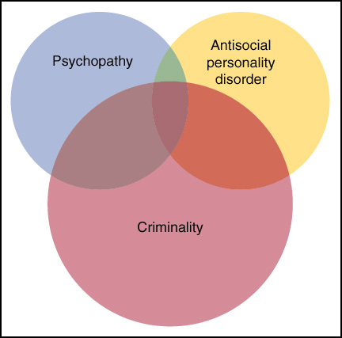
Cluster B: Antisocial Personality Disorder
Figure 12.2 Barlow/Durand, 3rd. Edition
Overlap and lack of overlap among antisocial personality disorder, psychopathy, and criminality

Slide 27
Anxious/Fearful Cluster
Avoidant personality disorder (PD) involves:
  People who are fearful in social situations.
  People who are keenly sensitive to criticism, rejection or disapproval; and
  People whose lives and job are restricted by their fear of negative interactions.
Prevalence of Avoidant PD is about 1 percent and this disorder is co-morbid with dependent PD and borderline PD.

Slide 28
Anxious/Fearful Cluster
Dependent personality disorder (PD) involves:
  A lack of self confidence.
  A lack of a sense of autonomy; and
  A view that others are powerful while they are weak.
Prevalence of Dependent PD is about 1.5 percent and occurs slightly more commonly in women than men.
May be related to insecure “anxious” attachment.

Slide 29
Is personality set in stone?

Slide 30
Is personality set in stone?
                No

Slide 31
Recognition of features.
Adjust expectations.
Motivational interviewing:
  Develop discrepancy
  Express empathy
  Amplify ambivalence
  Roll with resistance
  Support self-efficacy
How to engage with PD Clients?

Slide 32
Briefing and instructing psychologist experts
Mitigation vs risk.
Mental condition and causality as a hypothesis, not an objective fact.
Plea traversal and implications of not discussing offences:
          Need to declare
          Relevance to programs and risk estimate.
Individual deterrence prior to sentencing.

Slide 33
Judicious use of supporting material:
    No Justice Health File please!
    No drip feed brief
    Prior assessments; and
    Evidence of pre-existing condition.
S.14 applications when the defendant pleads not guilty.
A single assessment can only cover so much ground.
  Particularly relevant with neuropsychology.
When engaging a report to challenge an opinion, we will need the same material considered for the earlier opinion.

Slide 34
Critical Analysis of Risk Assessment Reports

Slide 35
It is not scientifically possible to accurately predict whether or not an individual will or will not actually harm someone.
As general rule, the less common the behavioural phenomena, the more difficult it is to predict; and
The best that can be offered is a risk estimate that is anchored to empirical evidence identifying features associated with risk; and sound clinical analysis and case formulation of how those present features might operate in the individual subject to the assessment.

Slide 36
What anchors a risk assessments?
Unstructured Professional Judgment
  “Based on my many years of experience I would say this offender will almost certainly be arrested again…”
  Most common form of decision-making in CJ system 25 years ago
Actuarial Risk Assessment
  Statistical formulas that combine “risk factors” to maximize predictive accuracy
  Mechanical process – no discretion
  Life & driving insurance rates, military and medical applications;

Slide 37
Predictive Accuracy of Risk Assessment Strategies with Sex Offenders
Greater Accuracy
1.0
0.8
0.6
0.4
.70
0.2
.42
Less
Accuracy
0.0
Professional
Judgment
Empirical
Actuarial
(Andrews & Bonta, 2007; Grove, et al., 2000; Hanson & Morton-Bourgon, 2007)
Notes:
Lecture (1-2 minutes):
Actuarial risk assessment tools are the culmination of many years of research exploring the specific combinations of risk factors that can lead to the best estimates of risk to re-offend. Because these measures are grounded in research, and because the scoring methods are designed to provide structure, consistency, and objectivity for the process, actuarial risk assessments tend to be more accurate than professionals’ subjective impressions about offenders’ risk. This is the case for actuarial risk assessment tools for “general” offenders as well as measures designed for sex offenders specifically (Andrews & Bonta, 2007; Grove et al., 2000; Hanson & Morton-Bourgon, 2007).
Risk assessment is not a perfect science, however. Even when using research-supported tools, it is not possible to identify with 100 percent accuracy whether a specific offender will – or will not – re-offend. But these tools are fairly reliable for differentiating higher from lower risk sex offenders, and they offer a better alternative than instinct or intuition alone.
Therefore, when judges consider an evaluator’s findings regarding a sex offender’s level of risk to re-offend, it is important for them to be aware of the risk assessment method used to make this determination.

Slide 38
How Should We Do Risk Assessments?
Which strategy does best job predicting new offences?
Sexual Recidivism
  Actuarial Measures .67
  Unstructured Clinical Judgment .42
Violent Recidivism (nonsexual)
  Actuarial Measures .78
  Unstructured Clinical Judgment .22
General Recidivism (any crime)
  Actuarial Measures .97
  Unstructured Clinical Judgment .11
Effect Size
* Hanson & Morton-Bourgon, 2009; Meta-analysis with 118 studies & 45,398 sex offenders

Slide 39
Should we stick with actuarial alone?
  Many items are static – cannot change gender or fact of prior arrest, so utility in guiding interventions is limited
  Do not take into consideration any risk factors that are not on scale - Static-99 for example misses:
    Detailed fantasies involving killing a victim & burying body in back yard
    Ongoing addiction to alcohol/drugs
    Participation in pornography exchange group
    Current access to victims through work

Slide 40

What might you ask about the use of a risk assessment tool?

Slide 41
Validity
Face Validity – Does the test appear to test what it aims to test.
Construct Validity – Does the test relate to the underlying construct.
Concurrent Validity – Does the test relate to existing similar measures.
Predictive Validity – Does the test predict the behaviour.

Slide 42
Interrater reliability
To what extent will equally qualified scorers arrive at the same score?

Slide 43

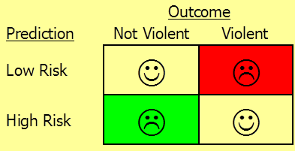
Transparency about how accurate the tools are?
Low error rates – specific area of concern depends on decisions being made and who is making the decisions
  False negatives - assessment says “low risk” – but really high risk because person recidivates
  False positives - assessment says “high risk” – but person doesn't’t or wouldn't’t have recidivated

Slide 44
Specificity vs. Sensitivity
Where do you place cutoff to determine high vs. low risk?
Low Risk
High Risk
0
1
Most cases labeled “high risk”
More False Positives – predict “high risk” but they don’t recidivate
Fewer False Negatives – predict “low risk” but they recidivate
Low Risk
High Risk
0
1
Small number of cases labeled “high risk”
Fewer False Positives – predict “high risk” but they don’t recidivate
More False Negatives – predict “low risk” but they recidivate

Slide 45
Receiver Operator Characteristic
In a Receiver Operating Characteristic (ROC) curve the true positive rate (Sensitivity) is plotted in function of the false positive rate (100-Specificity) for different cut-off points. Each point on the ROC curve represents a sensitivity/specificity pair corresponding to a particular decision threshold.
.50 = chance .55 = small .65 = moderate .7 = large

Slide 46
The extent that a randomly picked recidivist will have a higher score than a randomly picked non-recidivist.

Slide 47
PSC data from revalidation; AUC’s for other scales from Yang, Wong, & Coid’s (2010) meta-analysis on violence prediction

Slide 48
NOTE
The research is all based primarily on people who are charged/convicted or otherwise known to have committed an offence.
Therefore, there is a threat to validity in applying the scale to people who are not clearly determined to have committed an offence; and
This often complicates WWCC assessments in cases where there are no convictions.

Slide 49
Time adjustment
As a general rule, risk halves for every 5-10 years in the community without further charge or conviction; and
Becomes a relevant feature when assessing historical offences.

Slide 50
Examples of Dynamic Risk Factors for Sex Offenders
Sexual preoccupations
Access to victims
Intimacy deficits, conflicts in relationships
Pro-offending attitudes
Hostility
Non-compliance with supervision, treatment
Lifestyle instability
Notes:
Researchers have identified several dynamic risk factors associated with recidivism among sex offenders. Some of these risk factors are unique to sex offenders, whereas others are linked to recidivism for sex offenders and non-sex offenders alike (Andrews & Bonta, 2007; Hanson & Bussiere, 1998; Hanson & Morton-Bourgon, 2005, 2007).
Sex offenders are at increased risk when they engage in excessive or compulsive sexual behaviors or otherwise fail to manage their sexual urges (e.g., accessing sexually explicit materials, using prostitutes, frequenting sexually-oriented adult establishments).
Risk to re-offend is greater when sex offenders take steps to increase their access to victims or potential victims, such as seeking opportunities to have contact with children or other vulnerable individuals.
Having difficulties with establishing or maintaining intimate relationships, and/or having conflicts in intimate relationships, is linked to increased recidivism among sex offenders.
Sex offenders who have attitudes and values that support or condone crime pose a greater risk for recidivism.
Hostility and pervasive anger also contribute to recidivism among sex offenders.
When sex offenders fail to comply with supervision or treatment expectations, their risk to re-offend is greater than for hose who adhere to such expectations.
Recidivism risk increases for sex offenders who show problems maintaining a stable, pro-social lifestyle (e.g., abusing alcohol or drugs, behaving impulsively, having unstable employment or housing).
Slide 50

Slide 51

Variables Not Linked to Sex Offenders’ Recidivism:
Defensiveness and Denial?
Poor clinical presentation
How yucky or creepy the offence
Age of the victim
Age difference between victim and offender
Notes:
Lecture (2-3 minutes):
Some variables that are presumed to increase sex offenders’ recidivism risk are not actually demonstrated by research to be significantly correlated with recidivism (Hanson & Morton-Bourgon, 2005).
Maltreatment – whether physical, sexual, or emotional – is known to increase the potential that individuals in the general population may experience difficulties both in the short- and long-term (e.g., depression, anxiety, relationship problems, substance abuse). But in terms of recidivism, convicted sex offenders subjected to maltreatment during childhood are not significantly more likely to recidivate than those without those adverse developmental experiences. In other words, while maltreatment may increase the potential for adjustment difficulties, it does not cause people to engage in sexually abusive behavior, nor is it linked to greater recidivism potential among known sex offenders.
General mental health concerns, such as depression or anxiety, are not correlated with recidivism among sex offenders, either. They are important to address during the course of treatment, as typically relate to overall stability and adjustment but, in and of themselves, they do not predict recidivism.
Research does not indicate that factors such as denial, remorse, or victim empathy are directly linked to re-offending. Denial does pose a challenge to treatment providers, supervision officers, and others involved in sex offender management as it can prevent offenders from fully engaging in treatment efforts.
The fact that these variables are not linked to re-offending among sex offenders does not mean that they are irrelevant or unimportant, however. Judges oftentimes need to take factors such as denial and remorse into account when considering sentencing decisions, as they may relate to other goals of sentencing.
Slide 51

Slide 52

Formulation
Hypothesis of how the risk features work together in this case to create vulnerability to harm
What type of harm to whom?
What are the circumstances where risk is present?

Slide 53
Protective factors
Age
Health
Time
Maturation
Contextual/environmental factors

Slide 54
Assumptions about Recidivism
Lower reoffending rates for sex offences relative to other offence types.
11% for treated offenders; 17.5% for untreated offenders (Losel and Schmucker, 2005).
BOCSAR followed convicted sex offenders for 15 years from 1994, with 42% reoffending within that period (not restricted to sexual reoffending (2012); and
This was relative to: unlawful entry (81%), Robbery (75%), assault (64%).

Slide 55
Risk Management in Practice

Slide 56
Outside of sentencing, risk management is applied through:
Bail conditions.
Parole conditions.
CPR and CPPO.
High Risk Offenders Act.
Limiting term orders.
Community Treatment Orders; and
Guardianship orders.

Slide 57
Each of these functions have a responsibility to protect the community
BUT
Each service has finite resources.

Slide 58
Therefore, it is critical that those resources are used judiciously.
If everyone is high risk, no-one is.
Who you exclude is as important as who you include; and
The logic of “It can’t hurt” is dangerous.

Slide 59
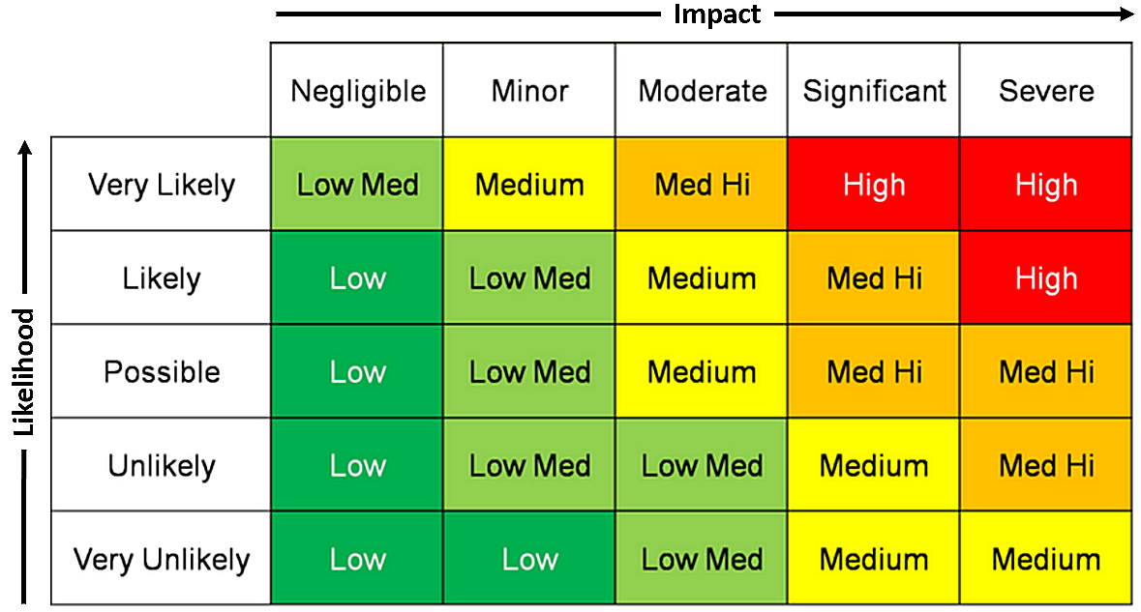
Risk Matrix

Slide 60
Child Protection (Offenders Prohibition Orders) Act 2004
(1) The Local Court may make a child protection prohibition order prohibiting a person from engaging in conduct specified in the order if it is satisfied that the person is a registrable person and that, on the balance of probabilities:
(a) there is reasonable cause to believe, having regard to the nature and pattern of conduct of the person, that the person poses a risk to the lives or sexual safety of one or more children, or children generally, and
(b) the making of the order will reduce that risk.

Slide 61
(3) In determining whether to make an order under this section against a registrable person, the Local Court is to consider the following:(a) the seriousness of each offence with respect to which the person is a registrable person,
(b) the period of time since those offences were committed,
(c) the age of the person when those offences were committed,
(d) the age of each victim of the offences when they were committed,
(e) the difference in age between the person and each such victim,
(f) the person’s present age,
(g) the seriousness of the person’s total criminal record,
(h) the effect of the order sought on the person in comparison with the level of the risk that a further registrable offence may be committed by the person,
(i) to the extent that they relate to the conduct sought to be prohibited, the circumstances of the person, including the person’s accommodation, employment needs and integration into the community,
(j) in the case of a young registrable person, the educational needs of the person,
(k) any other matters it thinks relevant.

Slide 62
A NSW Ombudsman report (2012) noted that applications for CPPOs were extremely low and as a consequence, between 1 January 2007 and 23 May 2012, only 71 CPPOs were issued by NSW Courts.
The report opined that despite the importance of such orders, they were not commonly used due to a lack of awareness of them within the NSW Police and associated child protection agencies.

Slide 63
Young people and CPR/CPPO
Risk is particularly dynamic in young people.
Developmental sex offences are understood to be a different phenomena than adult offending.
Identity and self concept are fragile for this cohort; and
There are dangers inherent in a young person entering adulthood defining themselves as a sex offender.

Slide 64
Orders should be bespoke
Any condition should speak specifically to the individual risk profile.
Fewer conditions the better.
Idiosyncratic vs diverse offending.

Slide 65
Good Lives Model (Ward 2002)
Rehabilitation framework adopted internationally and by CSNSW.
Generated by the need to articulate an idea of personal well being to offenders engaged in rehabilitation.
This is a lynchpin of modern offender rehabilitation over the past 20 years, but routinely overlooked in risk management plans.

Slide 66
How does the GLM relate to supervision?
To remind us that no amount of externally imposed rules will stop someone from reoffending. We ultimately rely of the defendant to decide not to reoffend
Conditions should be a mix of avoidance goals and approach goals
This is where CPPO are deficient. They can only specify what is prohibited and have no case management function.
Fewer conditions the better
Conditions should be specific to risk of what to whom, where and when
There is a need to balance risk management with cultivating a personal sense of agency and hope in the defendant

Slide 67
Common conditions that require closer examination:
Arbitrary rules about living x metres from childcare facilities
Rules about entering parks
Curfews
Rules about technology use
Rules about adult material
Rules about finances
Rules compelling education/employment
Electronic monitoring

Slide 68
What happens after sentencing?

Slide 69
Case Management and program pathway.
SMAP and associations.
Program prioritization based on LSI-R for general offenders and AOD offenders, Static-99R for sex offenders, and VRS for violence offenders.
Low-medium risk offenders will not be offered intensive programs.
Inmates with sentences of 10+years managed under Serious Offender Review Council (SORC); and
Inmate Security Classification system A-C.

Slide 70
CSNSW Compendium of Programs
https://correctiveservices.dcj.nsw.gov.au/documents/programs/CSNSW_Compendium_of_Offender-Behaviour_Change_Programs

Slide 71
2. Programs for inmates on remand
Remand Addiction
Remand Domestic Violence (DV)
3. Programs for short-sentenced offenders in custody
High Intensity Program Units (HIPUs)
High Intensity Program Unit (HIPU) – Violent Offender Therapeutic Program (VOTP)
Short Sentence Intensive Program (SSIP)
4. General Offender Programs
CONNECT
Real Understanding of Self-Help (RUSH)
EQUIPS Foundation
Macquarie Intensive Program (MIP) EQUIPS Maintenance

Slide 72
Addiction Programs
EQUIPS Addiction
Criminal Conduct and Substance Abuse – Pathways Compulsory Drug Treatment
Correctional Centre (CDTCC) Intensive Drug and Alcohol Treatment Program
(IDATP) IDATP – Women (Yallul Kaliarna)
IDATP Access
Addiction Support Groups
Aggression/Violence Programs
EQUIPS Aggression
EQUIPS Domestic and Family Violence
Violent Offender Therapeutic Program (VOTP)
Self-Regulation Program: Violent Offenders (SRP: VO)
VOTP – Maintenance & Outreach
Community-Based Risk Management Intervention for High Risk Violent Offenders
Countering Violent Extremism (CVE) Programs
PRISM
Terrorism High Risk Offender (THRO) Psychology Team HRMCC

Slide 73
Sex Offender Programs
HISOP – High Intensity Sex Offender Program
MISOP – Moderate Intensity Sex Offender Program (Custody and community-based)
Self-Regulation Program: Sexual Offenders (SRP: SO)
Deniers Program
Custody-based Maintenance Program
Community-based Maintenance Program
Community-Based Risk Management Intervention for High Risk Sexual Offenders
Young Adult Offender Program
Gurnang Life Challenge
Safe Driver Programs
Sober Driver Program (SDP) TRIP
Wellbeing Programs
Aboriginal Cultural Strengthening Program
Dads and Family (Aboriginal Babiin-Miyagang) Program
Mothering at a Distance (MAAD)
Out of the Dark

Slide 74
Consideration by the State Parole Authority (SPA)
Common reasons for refusal;
Risk to the community
Poor institutional behaviour
Unresolved or inappropriate accommodation
Failure to address offending behaviour

Slide 75
Useful references
Ware, J. & Mann, R. E. (2012). How should “acceptance of responsibility” be addressed in sexual offending treatment programs? Aggression and Violent Behavior 17, 279–288.
Marshall, W. L., Marshall, L. E., & Ware, J. (2009). Cognitive distortions in sexual offenders: Should they all be treatment targets? Sexual Abuse in Australia and New Zealand, 2, 21-33.

Slide 76
Hanson, K., & Bussiere, M. (1998). Predicting relapse: A meta-analysis of sexual offender recidivism studies. Journal of Consulting and Clinical Psychology, 66(2), 348-362.
Hanson, K., Gordon, A., Harris, A., Marques, J., Murphy, W., Quinsey, V., & Seto, M. (2002). First report of the collaborative outcome data project for the effectiveness of psychological treatment for sex offenders. Sexual Abuse: A Journal of Research and Treatment, 14 (2), 169-194.
Hanson, R. K. & Harris, A. (2000). The Sex Offender Needs Assessment Rating (SONAR): A method for measuring change in risk levels. Ottawa: Corrections Research, Department of the Solicitor General of Canada. Website: sgc.gc.ca.

Slide 77
Hanson, R. K. & Harris, A. (2001). A structured approach to evaluating change among sexual offenders. A Journal of Research and Treatment, 13(2), 105 – 122.
Hanson, R.K. & Harris, A. (2007). The Dynamic Supervision of Sexual Offenders (STABLE-2007). Corrections Research, Department of the Solicitor General of Canada. Website: sgc.gc.ca.
Hanson, R. K., & Thornton, D. (1999). Static-99: Improving actuarial risk assessments of sex offenders. Ottawa: Corrections Research, Department of the Solicitor General of Canada. Website: sgc.gc.ca.
Hart, S.D., Cox, D.N., & Hare, R.D. (2008). Hare Psychopathy Checklist: Screening Version (PCL:SV). Multi-Health Systems Inc.
Hart, S.D., Kropp, P.R., Laws, D.R., Klaver, J., Logan, C., & Watt, K.A. (2003). The Risk for Sexual Violence Protocol (RSVP) – Structured Professional Guidelines for Assessing Risk of Sexual Violence. Mental Health, Law, and Policy Institute, Simon Fraser University.

Slide 78
Campbell, M., French, S. & Gendreau, P. (2009) The Prediction of Violence in Adult Offenders: A Meta-Analytic Comparison of Instruments and methods of assessment. Criminal Justice and Behavior ; 36; 567
Douglas, K. & Skeem, J. (2005) Violence risk assessment: Getting specific about being dynamic. Psychology, Public Policy & Law, 11(3).
Wong, S.C.P., & Gordon, A. (2006). The validity and reliability of the Violence Risk Scale: A treatment friendly risk assessment tool. Psychology, Public Policy and Law, 12(3), 279-309.
Yang, M., Wong. S, & Coid, J. (2010) The Efficacy of Violence Prediction: A Meta-Analytic Comparison of Nine Risk Assessment Tools. Psychological Bulletin,136 (5), 740–767

