Slide 1
Emerging Technologies in the Criminal Justice System
Edward Santow
Co-Director, Human Technology Institute
Industry Professor – Responsible Technology, UTS
Linda Przhedetsky
Associate Professor, Human Technology Institute
Notes:
Introductory slide: 5 minutes – Ed
Introduce ourselves (I will check if we will be introduced by host)
About HTI

Slide 2
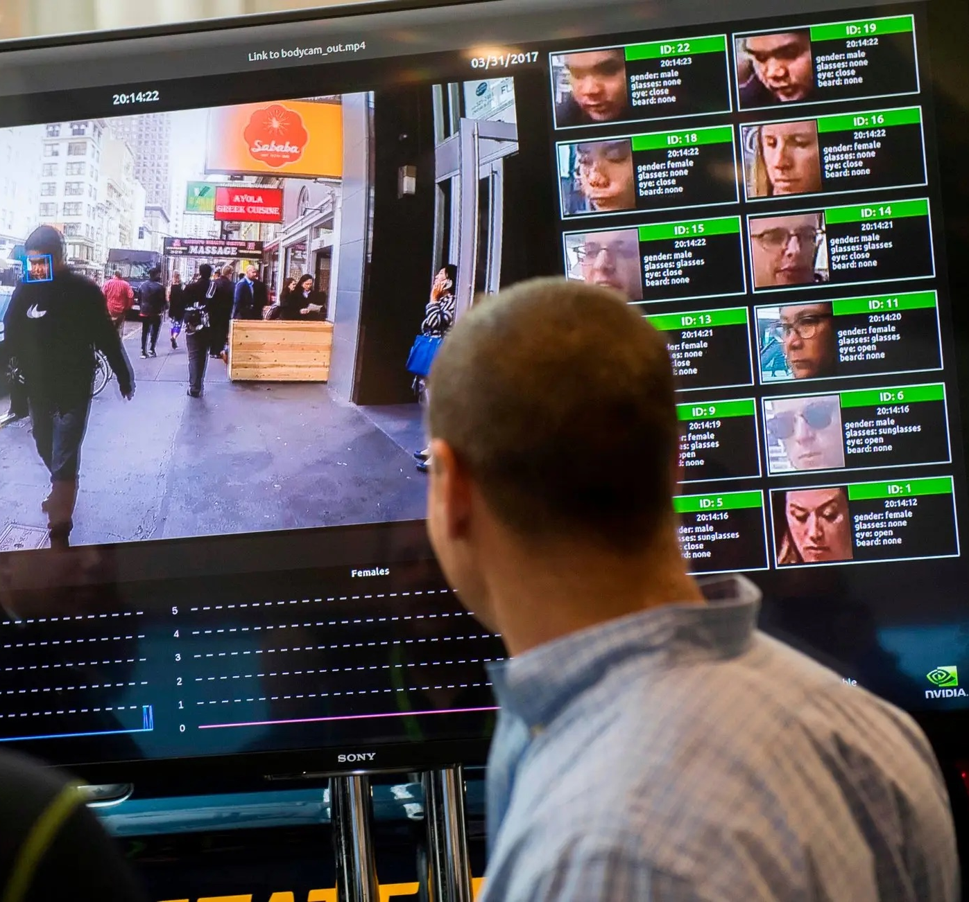
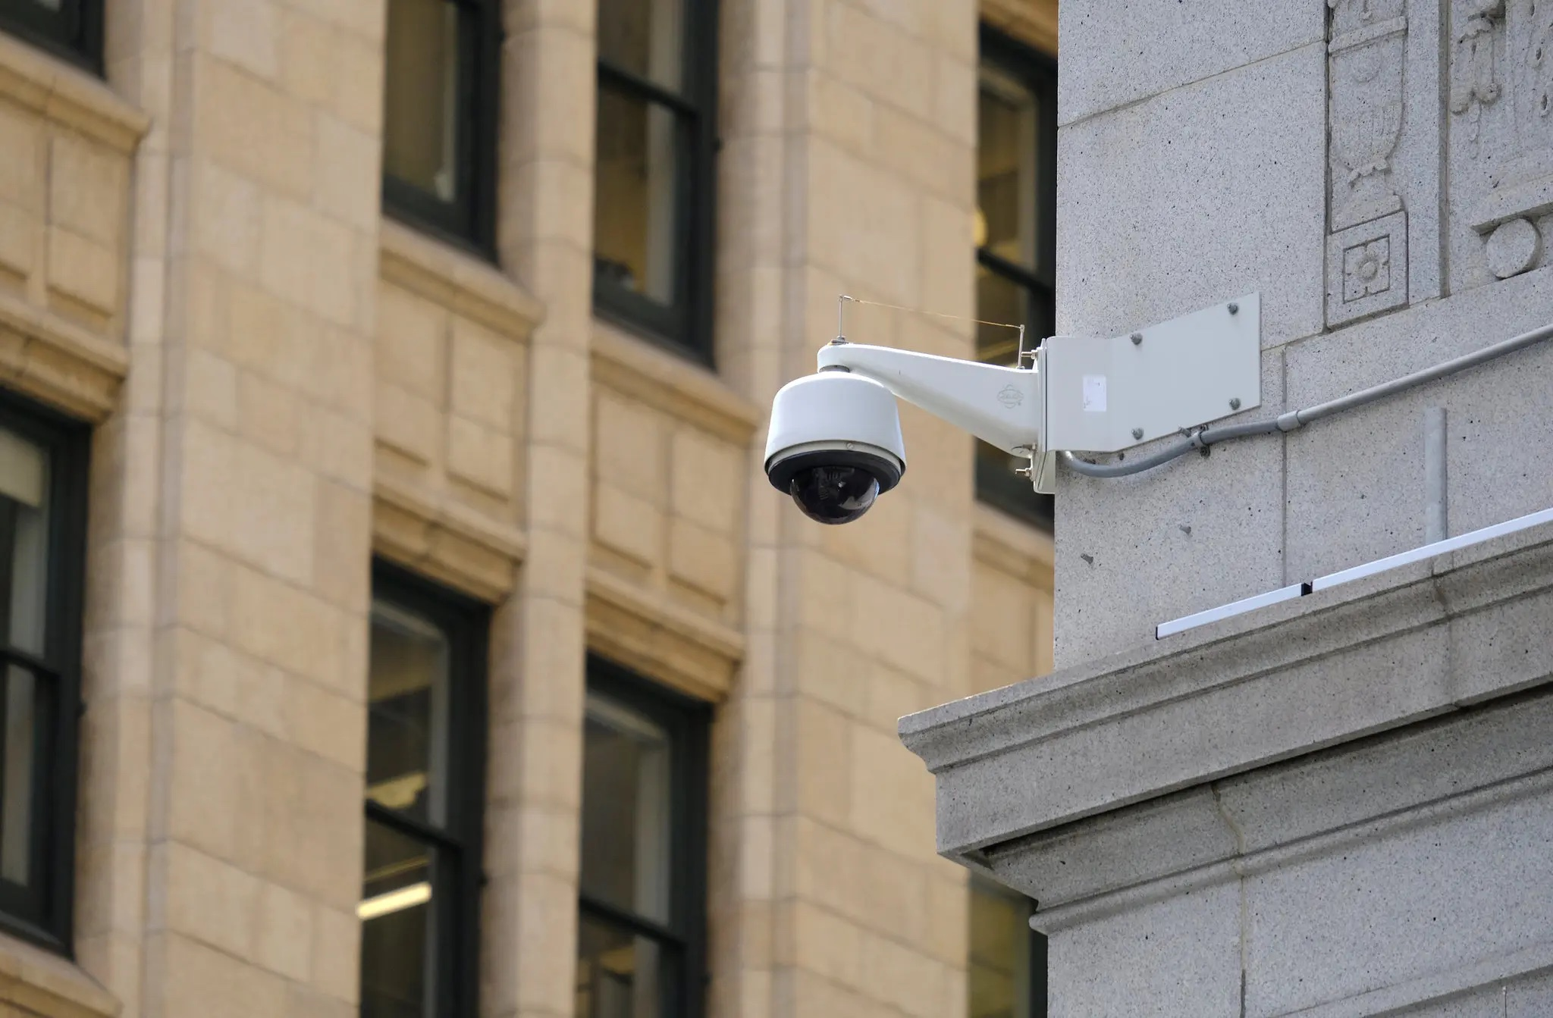
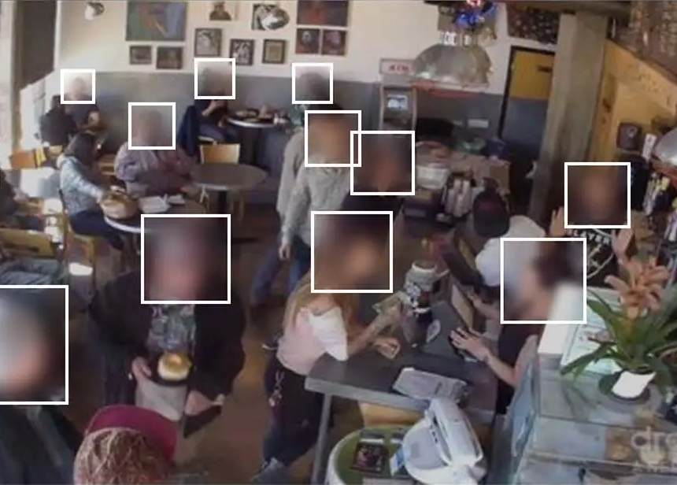
Notes:
5 minutes: Ed to present
Key points:
You may be wondering why we are talking you about about emerging technologies in the criminal justice system
When you think about the pressing issues that you are dealing with day to day, technology may not be the first thing that comes to mind
The reality is that emerging technologies are increasingly impacting all of us, and often disproportionately impacting the most vulnerable members of society
On the screen here, you’ll see a number of pictures that represent sophisticated facial recognition technologies that are embedded (often without our noticing) into public and private spaces. Facial recognition technologies rely on artificial intelligence to analyse images in real time, and match the images that they receive with the data that they possess about individuals.
The potential impacts of these technologies are immense:
ED TO PROVIDE A COUPLE OF EXAMPLES OF IMPACTS of FACIAL REGONITION TECHNOLOGIES IN CRIMINAL CONTEXT
These impacts are worrisome, and legal professionals are faced with situations where they need to know what these technologies are, how they work, how they are being used, and what impacts they are having in order to best support their clients.
HAND OVER TO LINDA to explain how these technologies work

Slide 3
Big Data
Machine learning
What is AI?
Massive computing power
Automation
Notes:
Linda to present: 5 minutes
On the previous slide, we saw examples of AI being used to to detect faces in public and private spaces.
While not every technology that we’ll discuss today is an example of AI, I want to step back for a minute and ensure that we have a working definition of artificial intelligence. This is partly to make sure that we’re all on the same page as we don’t expect anyone in the room to be a technology expert, but I’m also hoping to DEMYSTIFY these technologies a little.
A useful way of thinking about AI is to consider the four phenomena that are most commonly associated with AI:
Big Data : extremely large data sets that may be analysed computationally to reveal patterns, trends, and associations, especially relating to human behaviour and interactions.
Machine learning : systems that are able to learn and adapt without following explicit instructions, by using algorithms and statistical models to analyse and draw inferences from patterns in data.
Automation : technologies that allow human input to be minimized.
Massive computing power: the hardware that is involved in processing data. That involves Graphics Processing Units for processing large quantities of images, cloud storage, and other technological architecture to support the ability for machines to process data.
Together these four components are at the core of AI systems.

Slide 4
Machine learning is powering AI
Notes:
Let’s dig deeper into one particular concept – machine learning.
Machine learning is the most difficult, and most important, concept to explain when defining AI.
Machine learning is, essentially, a form of semi-automated pattern recognition.
This slide presents a simple worked example of a version of machine learning called supervised learning:
Imagine you want to use AI (ML) to identify the fruit in your fruit bowl.
At the start, your computer/machine doesn’t know anything about fruit. You have to train it to be able to recognise the different fruit.
This training process involves exposing the computer with as many pictures of the various types of fruit – oranges, apples, pineapples…
ML allows your computer to recognise the common patterns associated with particular fruit. For example, it will recognise that pineapples tend to be quite spiky; oranges have an orange colour; apples tend to be a particular shape with a stalk.
When you then show your computer a new picture of a fruit – an unlabelled picture that the computer hasn’t previously seen – it will look for the characteristics it has picked up from recognizing these patterns. It will provide an output (or prediction) based on those patterns.

Slide 5
Common myths about AI
1
AI is intelligent
AI is neither artificial nor intelligent (Crawford 2021).
2
AI is new
AI systems are all around us. The field dates to the 1956 Dartmouth conference.
3
AI is all about automated decision making.
$AI≠ADM.$
But AI can supercharge and scale ADM.
AI will save the world, or lead to human destruction
Unfortunately, the problem with this sentence is the word ‘or’. It might be better to say ‘and’.
4
5
AI must operate in a ‘black box’ so we can’t understand it.
AI systems are often opaque, but this is a design choice.
Notes:
Linda: 3 minutes
Now that we have working definition of AI, I want to debunk a few myths about AI technologies.
AI is made from vast amounts of natural resources, fuel, and human labour. And it's not intelligent in any kind of human intelligence way. It’s not able to discern things without extensive human training, and it has a completely different statistical logic for how meaning is made.
[Go through 1-5]
So – why am I telling you this? It’s largely because there is a lot of hype around AI systems, and this can lead to people and organisations placing unqualified trust in systems that are flawed.

Slide 6
Emerging technologies in the context of criminal law
You find out a predictive policing tool is being used to allocate where and when police should patrol certain areas
You are handed a brief of evidence that includes AI-generated analysis of your client’s online activities. This analysis ‘reveals’ that your client is ‘embedded’ within a criminal network.
A judge uses an algorithm that ‘predicts’ your client’s risk of reoffending.
Notes:
Linda: 5 minutes
Key point – not all of these will be AI!!!!!!
Key insight – these tools rely heavily on ML and (conventional) machine learning is essentially a powerful tool to bring to the surface patterns in data.
We all know that such patterns can be misleading.
'garbage in, garbage out'
[LINDA TO WRITE ELABORATION]

Slide 7
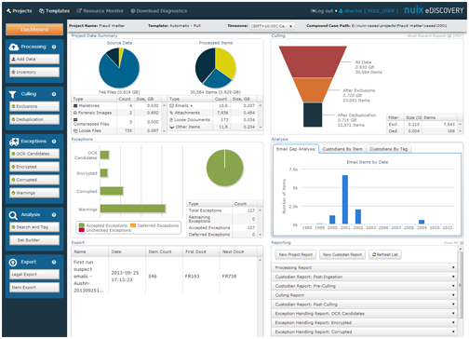
AI can help legal professionals and their clients
NALA, developed by Marrickville Legal Centre, helps triage clients, gathering vital information needed before consultation.
New legal software is becoming available to help streamline certain tasks in the legal industry (pictured: Nuix eDiscovery system)
Notes:
ED – 5 minutes
Key points:
Many positive use cases are available when AI is designed, implemented, and monitored correctly.

Slide 8
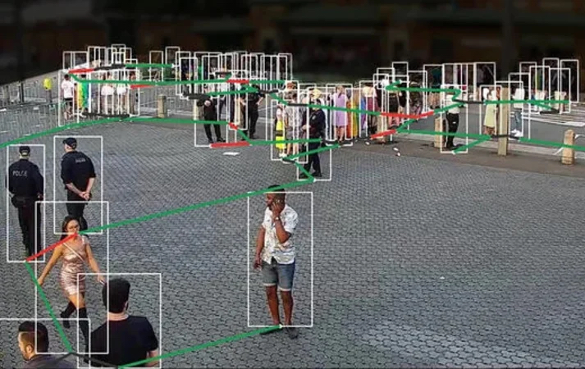
…but it can also create problems, and scale existing issues.
CCTV cameras designed to track people’s mood have been deployed in Sydney during events including WorldPride
Some predictive policing technologies have been shown to reinforce existing structural inequalities
Notes:
Ed – 5 minutes
Key points:
However, AI and other emerging technologies can create problems, and scale existing issues.
Example 1: speaking to new issues introduced through emotion recognition technologies
Example 2: Ed to speak to example of discrimination in the PIAC context
A decade ago, I was running the Public Interest Advocacy Centre. A kid asked us for help. Police officers were approaching him at school, in the street, and at home between midnight and 6am. They said they were ‘checking’ up on him. To our young client, this felt like harassment.
More kids followed. They weren’t hardened criminals. They were children – some as young as 12. They were frightened; humiliated.
Over time, we learnt that these children had been placed on the Suspect Target Management Plan. The NSW Police created this list using an algorithm trained on the state’s criminal justice database to identify kids at risk of crime.
At this point, we noticed something else: all these kids had dark skin. Not some; not most. Every single one. Parliament was later informed that more than half of the children on this list were Aboriginal, even though less than 3% of the state’s population is Indigenous.
The algorithm was reflecting the historical prejudice and injustice in our criminal justice system. Despite significant progress in addressing racist policing, this algorithm simply re-awakened the zombie of past discrimination.

Slide 9
Why should artificial intelligence be on your radar?
Massive increase in AI, including in the criminal justice sector
It isn’t always apparent when AI is being used.
AI isn’t magic; it is a powerful cluster of technologies that can be very useful, including in the criminal justice sector
AI can lead to errors, with extraordinary harm possible in criminal justice context
Lawyers need a minimum viable understanding of AI, to improve their practice and represent their clients effectively
Robodebt Royal Commission identified a way forward (see esp Ch 17 of the Report)
Community justice lawyers are on the front line → an opportunity to advocate
for systemic change
Notes:
Ed – 5
Key points on slide

Slide 10
Notes:
Ed – 5
You’ll remember this slide from the start of this presentation.
Now that we’ve provided you with some examples of how emerging technologies can impact your clients, let’s return to the example of facial recognition.
I’d like you to think about what questions or concerns might be raised at different stages of your work: [ED TO ELABORATE ON APPROPRIATE LAWYERLY QUESTIONS TO ASK AT DIFFERENT STAGES]
Pre-arrest
Arrest/Trial
Sentencing
Release

Slide 11
HTI Resources and Training
Over the coming months, HTI will be developing an educational resource that focuses on the impacts of emerging technologies in the criminal justice system, and the impacts of these technologies on clients.
This resource will be designed specifically for legal professionals working at Legal Aid, community legal centres and the broader community justice sector.
HTI will offer training to help professionals working in this sector. The training will provide foundational knowledge on emerging technologies relevant to your work and provide guidance on how to integrate the educational resource into your practice.
Notes:
Ed – 5 minutes
Key points:
Mention inspired by Bugmy Bar Book
Mention working with academics like Thalia Anthony
We aim to provide information about training offerings in coming months

Slide 12
Get in touch!
We would love to hear from practitioners who are eager to provide input into the project, and offer feedback on what we are developing.
Please email linda.przhedetsky@uts.edu.au
Notes:
Ed – 1 minute
Key point: we are really eager to receive feedback, case studies, and anything else that may be relevant to this project!

Slide 13
Questions?
Notes:
Questions – 10 minutes
Linda to clarify whether there is time for questions

