Slide 1
Drug Court

Slide 2
Who might be eligible for Drug Court?
Must be charged with eligible offences
Highly likely to serve a fulltime sentence of imprisonment
Have entered a plea of guilty or be willing to enter a plea of guilty
Be drug dependant (determination made by Health representative)
Usual place of residence is within the Drug Court catchment area
A person is not eligible if:
They are charged with an offence punishable under Division 2 of Part 2 of the Drug Misuse and Trafficking Act 1985, unless it is able to be dealt with summarily; OR
An offence involving violent or sexual conduct

Slide 3
Drug Court Catchment Areas
Dubbo Drug Court
Dubbo
Wellington
Parramatta Drug Court
Canterbury-Bankstown
City of Blacktown
City of Campbelltown
City of Fairfield
City of Hawksbury
City of Liverpool
City of Parramatta
City of Penrith
Cumberland
The Hills Shire
Sydney Drug Court
Bayside
City of Randwick
City of Sydney
Georges River
Waverley
Woollahra Inner West
Canada Bay
Burwood
Hunters Hill
Strathfield
Lane Cove
Mosman
North Sydney
Ryde
Willoughby
Hunter Drug Court
City of Cessnock
City of Lake Macquarie
City of Maitland
City of Newcastle
Port Stephens

Slide 4
Daniel has eligible offences for a Drug Court Program. Daniel has been living in Sutherland (out of area) since 2022 but says he can live with Dad at Redfern (in area) for the purpose of a Drug Court Program. Do you refer Daniel?
DANIEL

Slide 5
Usual place of residence
Where do you sleep most nights?
Where are your belongings?
Where does your mail go?
What is your address with Centrelink?
Where is your GP?
Where do you get you injection or methadone?
A person does not need to have a place to reside to be referred to the Drug Court

Slide 6
Samantha was bailed to an address in Wollongong (out of area) for three months before going into custody, she was reporting to Wollongong Police Station 3 times per week. She instructs you that she was never living in Wollongong in accordance with her bail and was living with her partner in Marrickville. Would you refer Samantha?
SAMANTHA

Slide 7
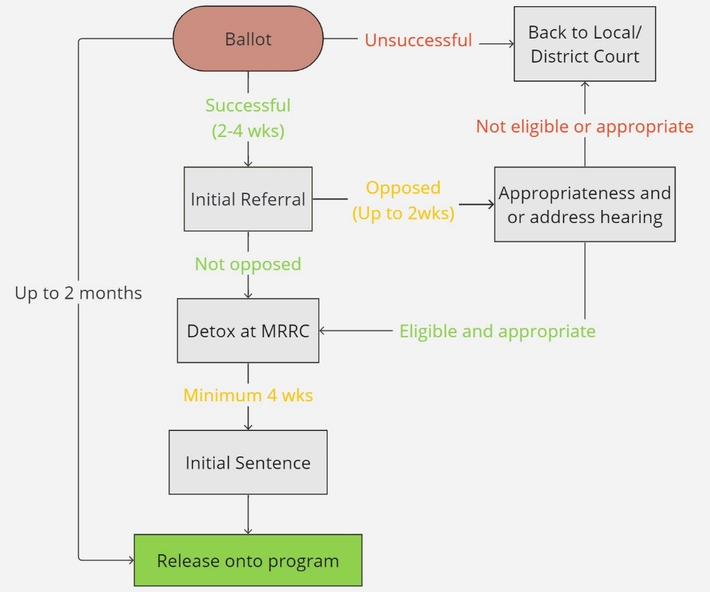
How does a client get onto the program?

Slide 8
Lincoln
It’s 3pm Lincoln is in custody and his private lawyer has not shown up today, the Magistrate has asked you to speak with him.
Lincoln is 28, he is charged with 5 sequences of Recklessly deal with proceeds of crime. He was previously charged with SI matters that have been withdrawn and matters are remaining in the Local Court.
The total amount of proceeds of crime is $1.5 million.
He tells you he has an addiction to cocaine, he has never used ice or heroin. He has a university commerce degree and was working in finance.
Would you refer Lincoln?

Slide 9
YES
Legal Aid is available to everyone referred to Drug Court – the means test does not apply
Drug dependency does not only limit itself to substances such as ice and heroin.
ADDICTION DOES NOT DISCRIMINATE
Large frauds may be an issue as the community expectation may be that a person should be sentenced at law
However Lincoln’s matters are remaining in the Local Court jurisdiction which gives rise to 5 years maximum. If the matters are in the District Court and the person is looking at over 6 years the person is likely to be found inappropriate

Slide 10
Brayden
Brayden is a 53 year old Aboriginal Man.
Brayden is charged with a police pursuit, drive whilst disqualified, possess prohibited drug 0.5 grams of ice and a bunch of fine only driving offences.
Brayden is on parole for drive whilst disqualified.
From 2010 – 2015 its hard to find anytime he wasn’t in custody for domestic violence related charges including AOABH and continually contravening his AVO.
In 2018 he was charged with Robbery and was sentenced to 3 years with NPP 18 months
Would you refer Brayden?

Slide 11
YES
Brayden would have some issues regarding appropriateness due to having violent matters on his record as well as the police pursuit
The court can impose conditions that mitigate these risks – such as no driving and no violence
Brayden may not come on however it is worth a referral
R v Tucker [2001] NSW DRGC 3 para 11 addresses the court having discretion over a person antecedents

Slide 12
Joshua
Joshua is 19 years old, his criminal history is 40 pages beginning in the Children’s Court and he is currently on an ICO for larceny. The ICO has been revoked.
He has 6 different H numbers which include pay wave type frauds, total being $3k and one deemed supply charge 5 grams of ice
You also notice an outstanding charge of Common Assault (DV) and Contravention of AVO listed for hearing at Parramatta in 3 months time.
Do you refer Joshua?

Slide 13
YES
Outstanding matters that are likely to result in a fulltime sentence will need to be vacated and brought to the Drug Court. If a person has outstanding matters they may be unavailable at the ballot stage. It is always helpful to find out if the outstanding matters are something they are willing to bring across to Drug Court – you do not need to vacate them to refer the client
The court can deal with current matters of violence if they are low level and not the main charge. The court can adj under s11 or impose a short fixed term using pre sentence custody. R v Tewake [2005] NSW DRGC 2
Revocation of an ICO or parole is not a barrier to a Drug Court Program.
Drug Court has a memorandum of understanding with Corrective Services, a persons revocation will be rescinded if accepted onto the Drug Court and their supervision will be transferred to the Drug Court.

Slide 14
Max
Max is charged with 2 sequences of ongoing supply of a prohibited drug (methamphetamines) and one possess prohibited drug (cannabis).
Max has 2 previous convictions for supply in 2010 where he received s12 good behaviour bonds for a period of 2 years.
In a conference with Max he says he is motivated to do the Drug Court Program and he was supplying to support his own habit.
Do you refer Max?

Slide 15
YES The supply can be dealt with summarily so is an eligible offence. However, the Crown may raise issues with his appropriateness due to the current charges and his history

Slide 16
Tori is on bail for 3 sequences of Break Enter and Steal. Tori uses ice on a daily basis and she was under the influence at the time of offending. You think Tori might get an ICO if she gets a good draw. She instructs she want to do Drug Court. Do you refer Tori?
TORI

Slide 17
Maybe
If Tori is on bail you should advise her that if she is accepted on to the program she should be prepared to go into custody for up to 6 weeks
You should advise Tori that by going to the Drug Court she must waive her right to a District Court Appeal.
You could always try your luck in the Local Court and Tori could be referred on a District Court Appeal

Slide 18
Who not to refer
Strictly indictable drug supply charges
Violent offences with no eligible referred offences or where the eligible referred offence would not attract a fulltime gaol sentence
Charges where fulltime custody is not likely
Current sexual offences
Prior participant who has not had three years since their final sentence date or NPP or conclusion of ICO imposed by Drug Court (which ever is later in time)
Previous applicants who were found not eligible or appropriate less than 2 years ago
Previous referrals to the ballot who were not successful in the ballot and have no additional H numbers
Commonwealth offences – exception where commonwealth sequences can be sentenced by Local Court and other sequences can be sent to Drug Court

Slide 19
Isn't Drug Court a get out of gaol free card?

Slide 20
Phase 1
Minimum 3 months
Phase 2
Minimum 4 months
Phase 3
Minimum 5 months
Attend court once per week
Curfew 7pm – 7am for the four weeks
Weekly home visits from community corrections officer
Weekly counselling appointments
Drug tests three times per week
Not able to do any paid employment
No alcohol
Attend court fortnightly
Start looking for work or positive activity such as tafe
Fortnightly home visits with community corrections
Fortnightly counselling appointments
Alcohol must be below BAC 0.05
Drug tests twice a week
Attend court once a month
Monthly counselling appointments
Monthly check in with community corrections
Need to be working minimum 3 days per week or engaging in positive activity 3 days per week
Alcohol must be below BAC 0.05
Drug tests twice a week

Slide 21
What does it take to Graduate?
Be drug free for 3 months
Employed or engaged in positive activity
Completed all three phases of the program and be on program minimum of 12 months
Must not have committed any crime in the last 6 months that if taken to court is punishable by imprisonment

Slide 22
What is the capacity of the Drug Court?
Dubbo: 80
Hunter: 80
Parramatta: 160
Sydney: 160

Slide 23
Current numbers for each location *as at Monday 24 June 2024
Dubbo
Total: 24
ATSI: 18
Hunter
Total: 69
ATSI: 26
Parramatta
Total: 164
ATSI: 74
Sydney
Total: 64
ATSI: 18

Slide 24
Compulsory Drug Treatment Correctional Centre (CDTCC)
A person is eligible for CDTCC if the person has been sentenced to a term of fulltime imprisonment and at the time that the sentence was imposed—
there is at least 18 months left on their NPP , and
The total time left on sentence is no more than 6 years
The person is drug dependant and the offence was related to the person’s long-term drug dependency
A person is not an eligible convicted offender if—
the offence for which the person has been convicted involved the use of a firearm, or
the person has been convicted at any time of any of the following—
murder, attempted murder or manslaughter,
sexual assault of an adult or child or a sexual offence involving a child,
any offence involving the violent use of a firearm,
an offence involving a commercial quantity or large commercial quantity of a prohibited plant or prohibited drug,

Slide 25
Questions?

