Slide 1
Criminal Law Conference
Justice Health NSW
Dr Katerina Lagios, Co-Clinical Director
Craig Cooper, Service Director
Drug and Alcohol Services

Slide 2
Acknowledgement of Country
We acknowledge the traditional custodians of the country in which we live on, work on and walk upon and pay respect to ancestors, elders, past, present and future.
Always was and always will be unceded Aboriginal lands.

Slide 3
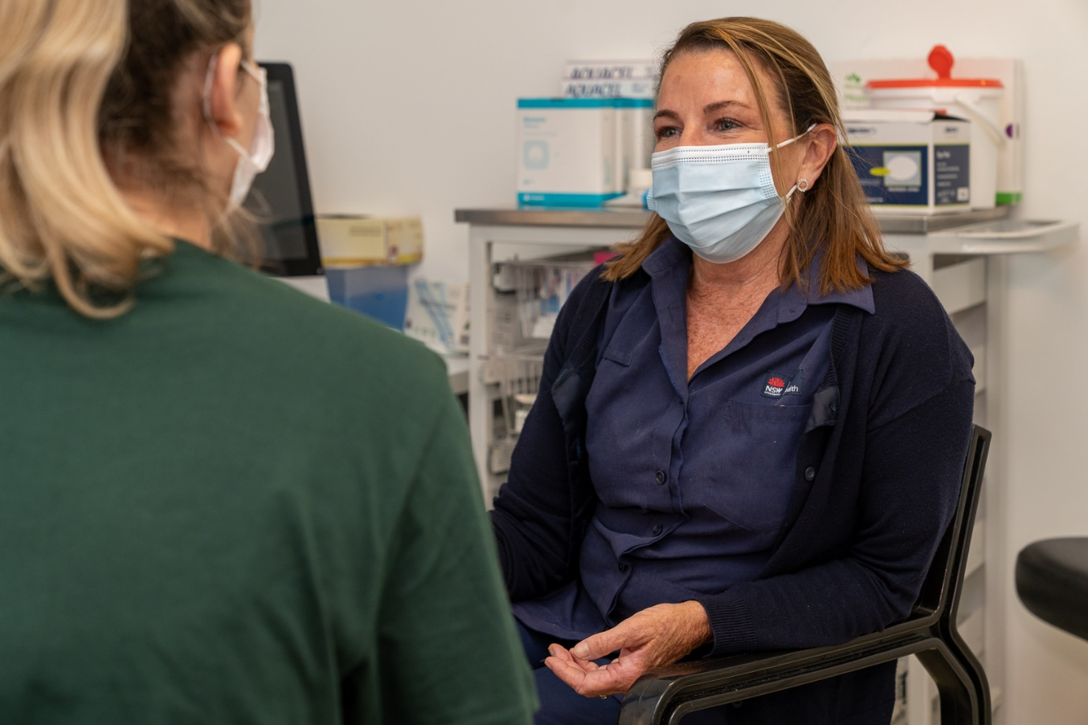
Justice Health NSW
Who are we?
Justice Health NSW is a Statutory Health Corporation established under the Health Services Act (NSW) 1997 that provides healthcare across secure inpatient, custodial, court and community settings.
We deliver healthcare services to adults and young people who come into contact with, or who are at risk of coming into contact with the criminal justice system.

Slide 4
Health Status
Adult Patients in Custody

Slide 5
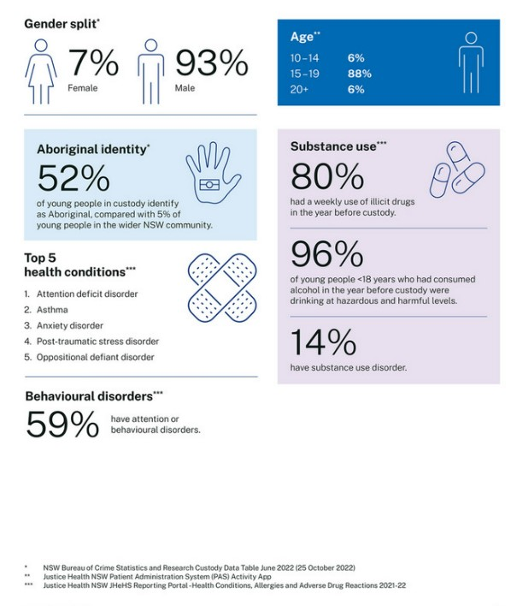
Health Status
Adolescent Patients in Custody

Slide 6
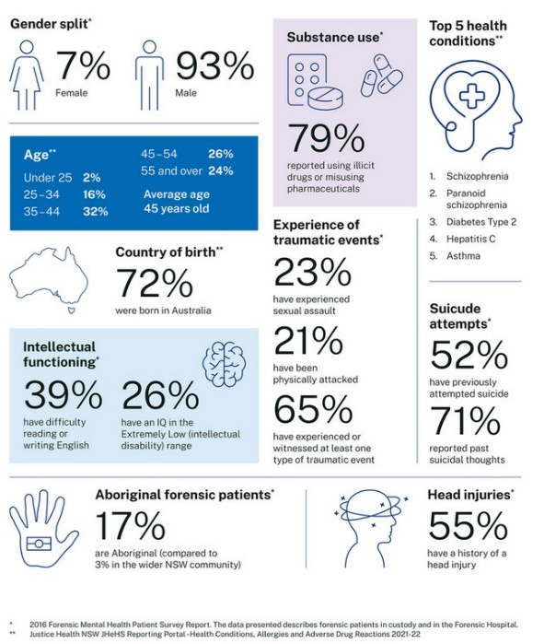
Health Status
Forensic Patients

Slide 7
Our Vision
To transform lives by delivering healthier tomorrows through excellence in patient-centred care across community, inpatient and custodial settings.
Notes:
is a catalyst for change and at the heart of our plan is our people. Our staff, patients and their families and carers.
Our vision is clear – to transform lives by delivering healthier tomorrows through excellence in patient-centred care across community, inpatient and custodial settings.
It is transformational, bold and over the next 10 years our focus places our patients at the centre of what we do.

Slide 8
Principles of Care
Defines the delivery of health services, and
the Principles of Care are:
Holistic and person-centered
Culturally guided
Excellence in safety and quality
Connected and coordinated
Efficient and effective
Notes:
Our Model of Care broadly defines the way health services will be delivered in Justice Health NSW in the future.
It aims to ensure patients get the right care, at the right time, by the right team, in the right place.
Our Model of Care principles are:
Holistic and person-centred
Culturally guided
Excellence in safety and quality
Connected and coordinated
Efficient and effective

Slide 9
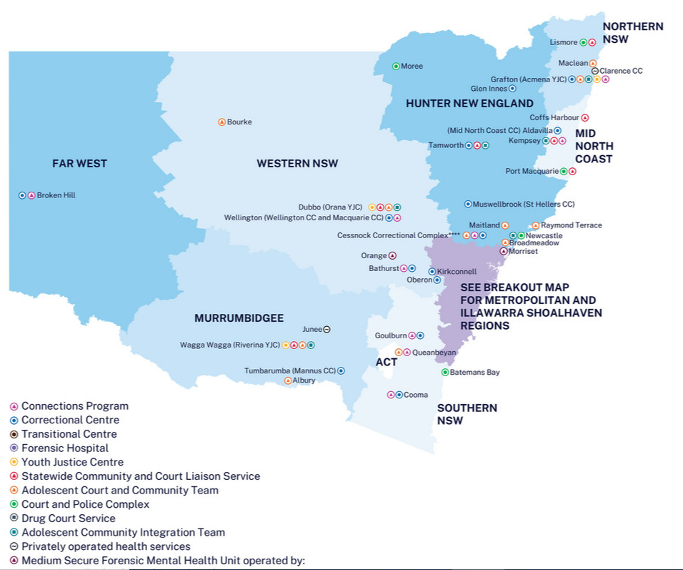
Partnerships and Engagement
Corrective Services NSW
Community Corrections
Legal Services
Aboriginal Community Controlled Sector
Local Health Districts
Primary Health Care Networks
Youth Justice NSW
Whole of Government
Ministry of Health

Slide 10
NSW Custodial System
12, 686 people are currently in custody. 30% of all people in custody in Australia.
30 publicly operated correctional and 3 privately operated.
Remand: 41.8% of people are on remand.
Movements: on average a person will move correctional centres 4 times per year. ~ 1000 persons a week.

Slide 11
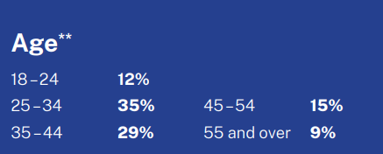
Patient Profile
Male – 93.6%
Female – 6.4%
Non-Aboriginal - 69.1%
Aboriginal – 30.4%
Culturally and Linguistically diverse – 14%
Top 5 drugs used
1. Stimulant type substance
2. Cannabis
3. Heroin
4. Benzodiazepines
5. New psychoactive substance
Source: BOSCAR, 2024
Source: People in NSW Public Prisons: 2020 Health Status and Service Utilisation Report
Source: Justice Health NSW 2023 Year in Review
Source: Justice Health NSW 2023 Year in Review

Slide 12
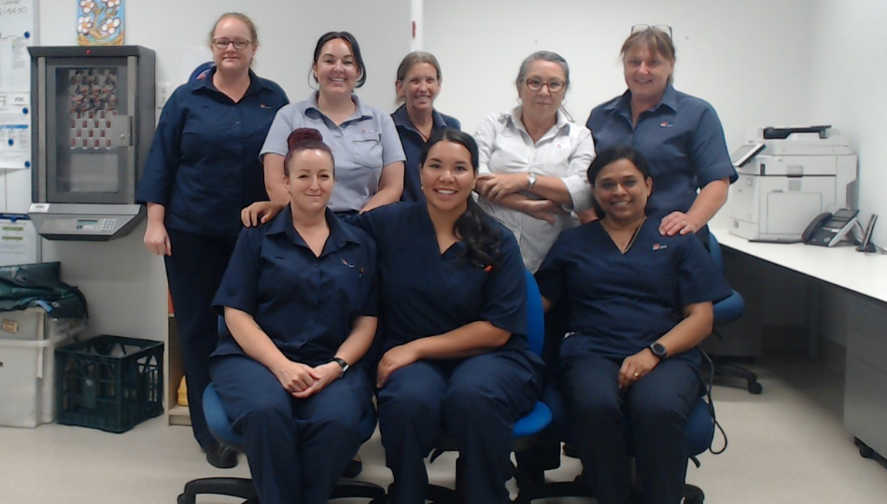
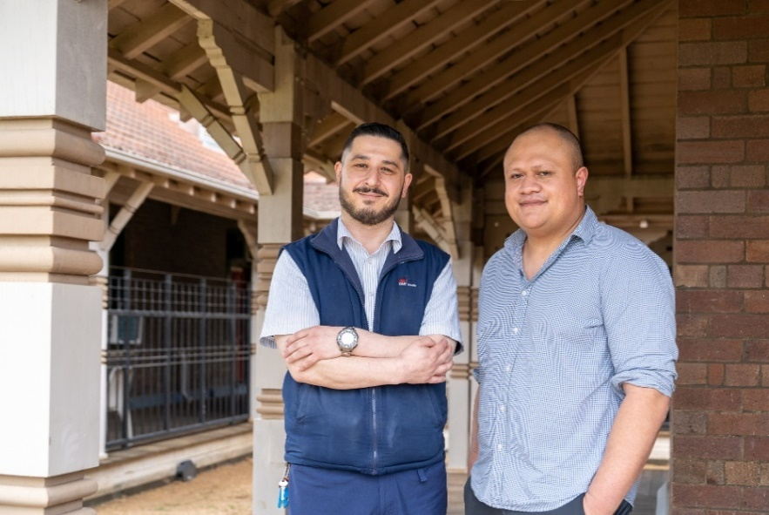
Clinical Directorates
Primary Care
Forensic Mental Health
Population and Preventative Health
Notes:
My personal commitment includes – Town hall updates, listening and leading to role model CORE values. Great if you can share a story on why CEO role matters to you.

Slide 13
Primary Care
Key functions are:
nursing operations
medical operations
oral health
adolescent health
allied health – radiology, physiotherapy
inpatient services (including Long Bay Hospital)
access, demand, logistics and CSNSW liaison
integrated care and community partnerships

Slide 14
Primary Care
Provides:
disease management
interventions to identify and manage acute and chronic conditions
referrals to specialist services
gender specific services to women in custody
Services include:
Primary Care Doctors and Women's Health Nurse Practitioners
Mental Health Consultation Liaison Nurses
Oral Health
Optometry
Physiotherapy
Radiology
Specialist – Dermatologist, Respiratory Physician
Palliative Care
Medical Appointments Unit

Slide 15
Forensic Mental Health
Forensic Hospital (FH) is a high secure, 135 bed, mental health facility providing specialist mental health care to male, female, adult and adolescent forensic and correctional patients and a limited number of high-risk civil patients. The FH is the only high secure mental health in-patient facility in NSW. Clinical services are delivered by multidisciplinary teams, who provide recovery-oriented treatment, which includes offence specific rehabilitation, in line with Forensic Mental Health dual obligation to address mental health and (re)offending needs. Note: The Forensic Hospital will be operationally commissioning the Freshwater Unit in FY 2024-25. This will be the state’s first high secure mental health intensive care unit and will prioritise admissions for adult male correctional patients requiring involuntary treatment.
Custodial Mental Health ​​​​(CMH) comprises of assertive care and mental health outreach services. This includes: - Long Bay Hospital Mental Health Unit (40 beds). This unit is exclusively accessed by adult male patients, noting adult female patients access the Forensic Hospital when requiring care under the Mental Health and Cognitive Impairment (Forensic Provisions) Act 2020. - Silverwater Correctional Complex Mental Health Screening Units, which are designated assertive care areas and comprise of 43 cells for men, and 10 cells for women. - CMH also provide telehealth and outreach care across the public correctional centers and include mental health nursing and psychiatry services.

Slide 16
Statewide Community and Court Liaison Service (SCCLS) aims to provide Magistrates with an option to divert defendants away from the criminal justice system to civil inpatient and community mental health services, or other supporting intervention options.
The SCCLS currently operates in 29 courts across metropolitan and regional NSW.
The service is currently expanding and by the end of 2026 will be operational in 56 courts.

Slide 17
Forensic Mental Health
Community Forensic Mental Health Service (CFMHS) provides specialist care, intervention, support, advice and training to people who have a serious mental illness and are in contact, or at risk of contact with the criminal justice system.
There are three services that comprise the CFMHS1) Community Transitions Team (CTT), which offers release planning and transitional support to people with serious mental illness, with known histories of treatment disengagement leaving custody. 2) Consultation and Liaison Team (CLT), which provides specialist consultation, advise, and independent medico-legal reports to support the safe care of forensic and at-risk civil patients engaged with Local Health District (LHD) mental health services. 3) Treatment and Rehabilitation Clinic (TRC), which is a newly established service providing bio-psycho-social treatment to people at high-risk of engaging in sexual offending and includes patients on Extended Supervision Orders as well as forensic and LHD patients. :

Slide 18
Forensic Mental Health
Adolescent Forensic Mental Health (AFMH) team delivers adolescent mental health and drug and alcohol services to young people who are in contact, or at risk of contact with the criminal justice system. AFMH services work across Court, custody and community to ensure vulnerable young people get access to early intervention and mental health and drug and alcohol care.
The services provided include: - Early intervention services, working with at-risk young people prior to their engagement in the criminal justice system - Court diversion services to re-engage and divert young people into mental health care and other community-based supports - Custody-based mental health and drug and alcohol services, as well as custody-based diversion, to enable access to treatment and support through-care - Release planning and community reintegration supports (via the Community Integration Team – CIT) to prevent young people from falling through service gaps and ensure access to community-based care - Prevention services, via the newly established Safeguards service, which aims to address risk and improve access to mental health care and other supports as a means of preventing at-risk young people’s (re)engagement with the criminal justice system.

Slide 19
Forensic Mental Health
Services Include:
Psychiatry
Mental Health Nursing
Psychology – including both Forensic and Clinical
Occupational Therapy
Social Work
Speech Pathology
Eating Disorders
Art Therapy

Slide 20
Justice Health NSW Other Directorates
Nursing, Midwifery & Clinical Governance
Nursing Clinical Governance
Digital Health and Information Directorate
SDHR – 2026 with HNW LHD
Executive Medical Services Directorate
Professional Leadership and Standards
Pharmacy
Research

Slide 21
Population and Preventative Health
Clinical Streams:
Population Health – STIs, BBVs, Communicable Diseases, Public Health Response
Drug and Alcohol Services
Allied Health Directorate
Strategy and Governance for Allied Health initiatives and workforce
Professional leadership for all 15 allied health professional groups, representing over 170 staff
Notes:
Allied Health Strategy and Governance (sharepoint.com)

Slide 22
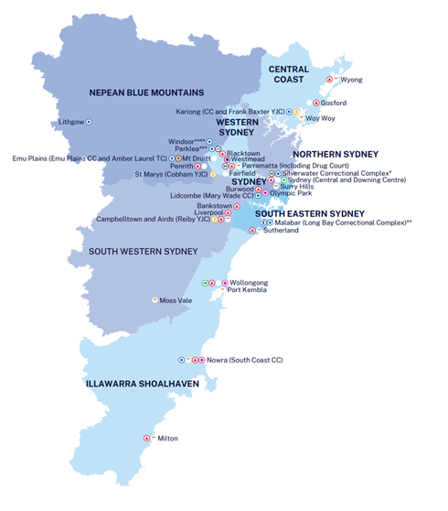
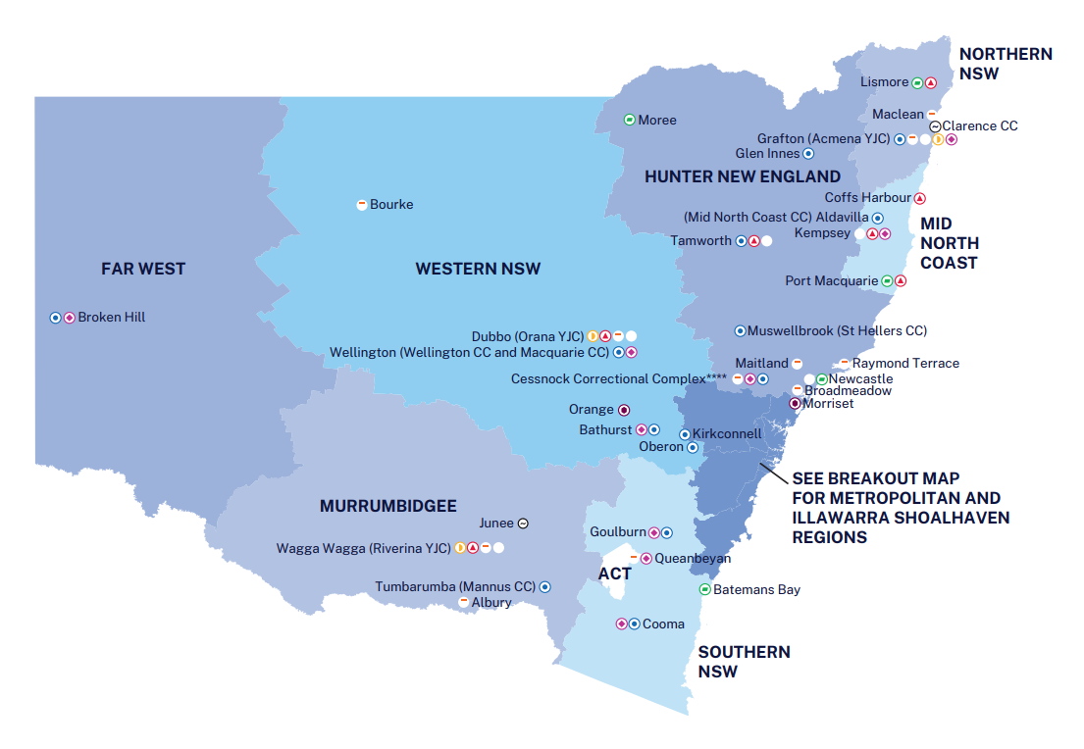
Drug and Alcohol Services
Addiction Medicine Specialists
Nursing
Allied Health
Diversionary
Programs
Substance Use in Pregnancy Service
Aboriginal Health
Opioid Agonist Treatment
Pre / Post Release Support
MDT
Care
Clinical Education Program
Research Monitoring Evaluation

Slide 23
Population Health
Hepatitis C Services:
Screening and innovative testing models – Dried Blood Spot and Point of Care
Nurse Led Model of Care for HCV and NP prescribing treatment
HCV Linkage to care Pilot with inner Sydney
Commencement of a 3-year HCV and Harm Reduction research and implementation project
Development of Justice Health NSW HCV elimination plan
Leading the state in HCV initiations since introduction of Direct Acting Antivirals in 2016
Notes:
Context of access to health care/ how health care is provided in custody – health centre centric - access to health information

Slide 24
Population Health
Harm Reduction:
State-wide expansion of a Peer Harm Reduction Model
Workforce development – mandatory Harm Reduction training for all new Correctional staff
An online learning module and videos for patients
Take Home Naloxone
Pilot of a new disinfectant for syringe cleaning
Brief Intervention’s

Slide 25
D&A Models of Care
for people with substance use disorder
Risk assessment / intoxication and withdrawal management for all patients entering custodial system
* Reception Screening Assessment
* Continuation of treatment
* 24 hours Remote Offsite Afterhours Medical Service
* Referral to D&A, Population Health, Mental Health teams for assessment and review
Multidisciplinary Team (biopsychosocial) Model of Care, including Aboriginal Health and Allied Health
People with lived and living experience, consumer engagement and peer programs
Trauma informed care
In court (diversionary), in custody, and post release (transfer of care) services
* MDT approach care plan development
Notes:
Context of access to health care/ how health care is provided in custody – health centre centric - access to health information

Slide 26
Services for People with Substance Use Disorder
D&A Services and Programs:
Opioid Agonist Treatment (OAT)
Psychosocial Services – Psychosocial Brief Interventions and Groups (BIG) Program
Multidisciplinary Care and Reviews
Substance Use in Pregnancy Service
Diversionary Programs:
Drug Court Program – Parramatta, Hunter, Sydney (now 5 days per week) and Dubbo
Walama Program (Aboriginal Court Diversion)
Compulsory Drug Treatment Program
Release Planning and Transfer of Care (includes the above):
OAT Discharge Planning Service
Connections program, in tandem with the Post Custodial Support Program

Slide 27
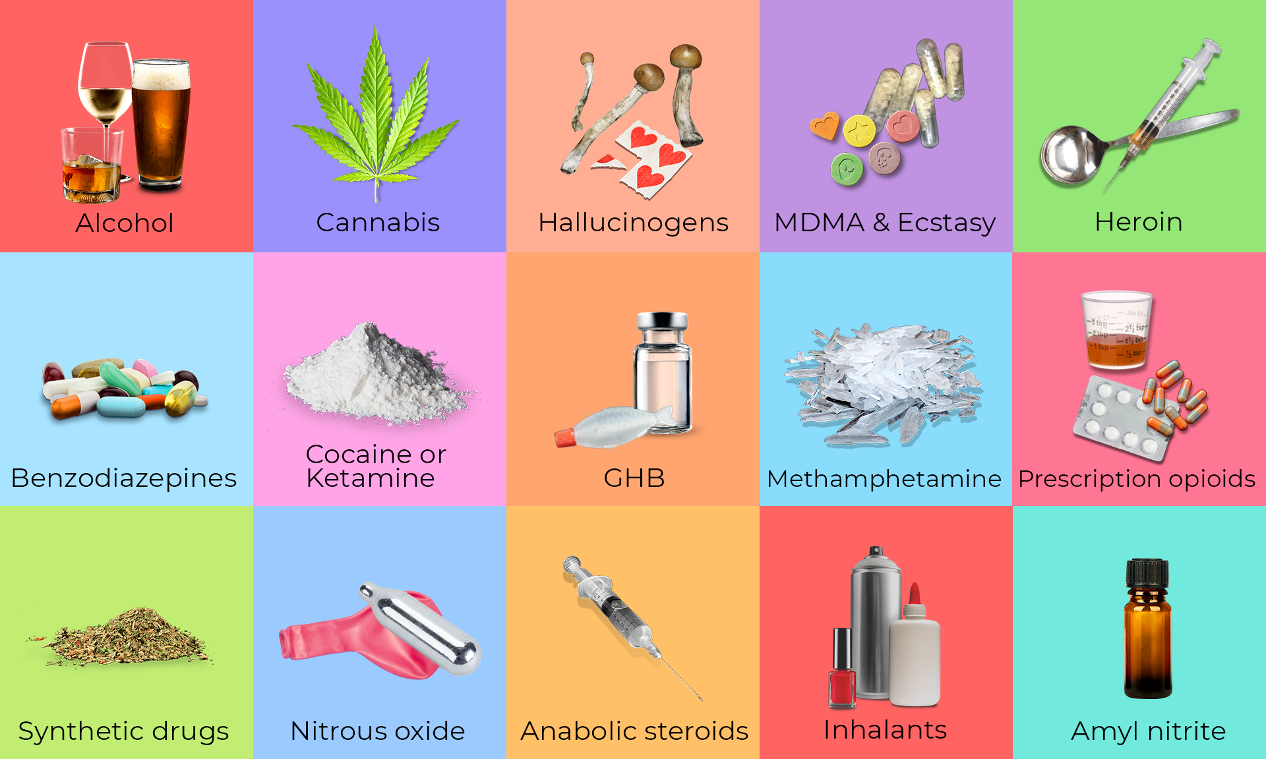
Drug Use amongst people in Custody
Analysis of Justice Health NSW Reception Screening Assessment (RSA) Data FY22/23 = 12,183
6806 (56% of RSAs) reported substance use and 30% reported alcohol use
Of patients reported substance use 37% (2552) identified as Aboriginal

Slide 28
Dug and Alcohol
OAT Trends
During FY 22/23:
1025 patients commenced on OAT
2099 patients released to community on OAT. Of those 1601 (76%) on Depot Buprenorphine and 498 (24%) on Methadone
On last day of April 2024 total of 1765 patients were on OAT, 1524(86%) on Depot Buprenorphine and 241(14%) on Methadone

Slide 29
Co-morbid Health Conditions
Population Health
Hepatitis C
Primary Health
Hypertension
Oral
Health
Dental caries
Mental Health
Hepatitis B
Cirrhosis of liver
Gonorrhoea
Syphilis
Chlamydial infection
Herpes
Myocardial infarction
Chronic obstructive pulmonary disease (COPD)
Asthma
Diabetes Type 2
Arthritis
Diabetes Type 1
Cancer (any)
Dental trauma
Periodontal disease
Schizophrenia
Bipolar disorder
Drug-induced psychosis
Depression
Anxiety Disorder
Acquired brain injury
Advanced Liver Disease
Posttraumatic stress disorder
Borderline personality disorder

Slide 30
The BIG Program
Brief Interventions – delivered brief interventions to 3469 patients since May 2023
22% Female and 42% Aboriginal patients
Group Pilot sites:
GEO Program (Dillwynia 2, Mid North Coast, Broken Hill, Hunter)
BIG (Cessnock complex, Broken Hill, Silverwater complex, Dillwynia, Mid North Coast, Wellington, South Coast, Goulburn)
Consumer Engagement and Contribution
Participants were surprised by how useful the groups were
The rapport and trust with staff helped with the group dynamics and ability to open up in the groups
Participants enjoyed having their lived experience listened to and respected by the facilitators

Slide 31
Case Study – 1
Peng 34 years
Peng is a 34-year-old man, immigrated at the age of 13 from China.
His primary drug of choice on entry into custody was methamphetamines, cannabis, benzodiazepines, with occasional opioid use.
On entry to custody (reception), Peng reports anxiety and depression, and prescribed Mirtazapine 30mg at night. He was assessed prior to hospital as having psychosis, exacerbated by his cannabis use and is being managed well with prescribed olanzapine 10mg bd.
Due to the lack of drug availability in custody, Peng develops opioid use disorder.
OAT:
Peng self refers and has been on the OAT waiting list at the South Coast correctional centre for 4 months.
During the OAT assessment, Peng has tested positive for HCV and referred to Population Health for HCV treatment work-up.
Peng has moderate opioid dependence and commences OAT, 12 months after entering custody.

Slide 32
Case Study – 2
Katrina 23 years
Katrina is a 23-year-old First Nations woman. Polydrug use on entry into custody, includes methamphetamines, cannabis, and opioids.
On reception, Katrina reports sporadic engagement with Health Services, and is screened for and found to be pregnant. Katrina does not know.
Katrina is treatment naïve, assessed as being in withdrawal, and has an opioid use disorder.
OAT:
Katrina is in Silverwater women's and transferred to Dillwynia within 3 weeks.
Katrina’s withdrawal on entry into custody is managed, the pregnancy discussed, and depot buprenorphine commenced.
Substance Use in Pregnancy referral made, Aboriginal Health Worker cultural care engaged, and Buvidal® commencement closely monitored.

Slide 33
Case Study – 3
Steve 52 years
Steve is a 52-year-old man, with repeat criminal justice system engagement and incarcerations, since 13 years of age.
Steve has been on OAT 6 times since the age of 19, with opioids as his primary drug of choice. Steve has consistent problems finding, securing and retaining accommodation and independent living.
This stint has seen Steve in custody for 3 years and was on OAT when he entered custody. He has contact with his family and children.
OAT:
Steve is stable on OAT, referral made to the Connections Program 3 months ahead of release from custody.
During the Connections assessment, Steve indicates he wants to return to the Inner-West and to receive his Buvidal®. The pharmacy he was being dosed at previously administers depot buprenorphine.
Accommodation and employment are also identified as goals for Steve by Connections.

