Slide 1
CAPUCHiN MONKEYS, HENRY vIi, ROCK STARS AND LEGAL AID
Justice Hament Dhanji

Slide 2
Capuchin Monkeys: A lesson in parity
Image source: Xavier Cervera, Panos Pictures/Redux

Slide 3
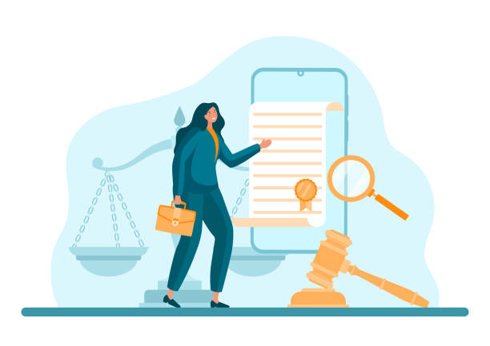
A History of Legal Aid
Facilitating access to justice
Source: iStock Photos

Slide 4
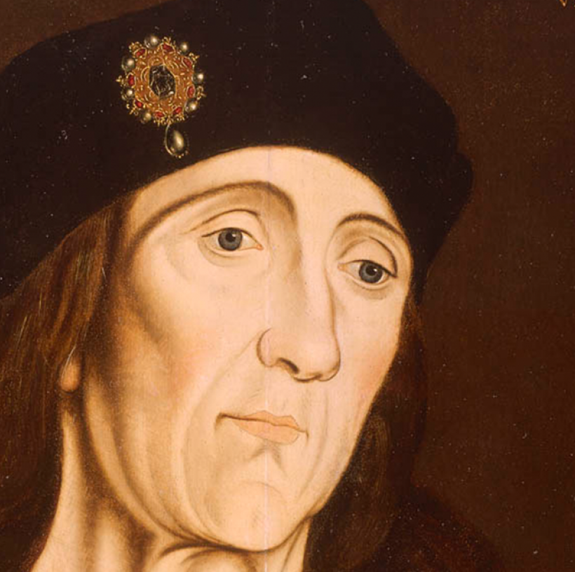
King Henry VII
A mean to help and speed poor persons in their suits (1495)
The King:
“willeth and intendeth that indifferent justice be held and ministered according to his common laws, to all his true subjects, as well as to the poor as rich, which poor subjects be not of ability nor power to sue according to laws of this land for the redress of injuries and wrong to them daily done, as well concerning their persons and their inheritance as other causes.”
Source: Royal Museums Greenwich

Slide 5
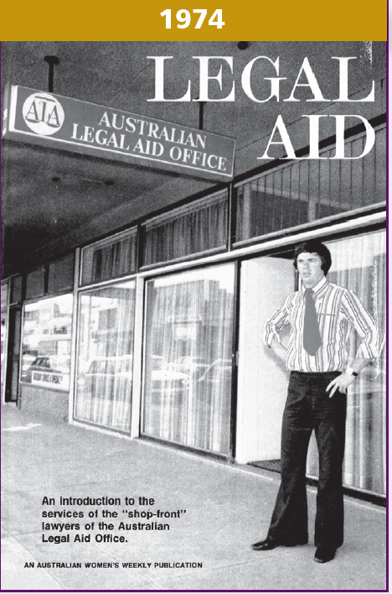
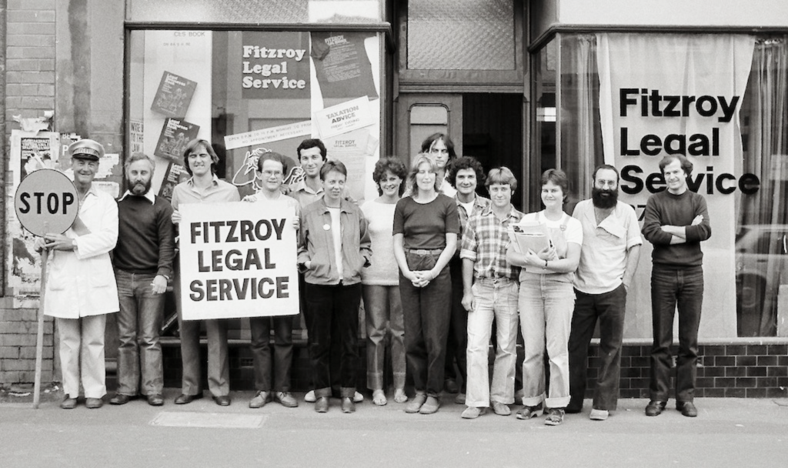
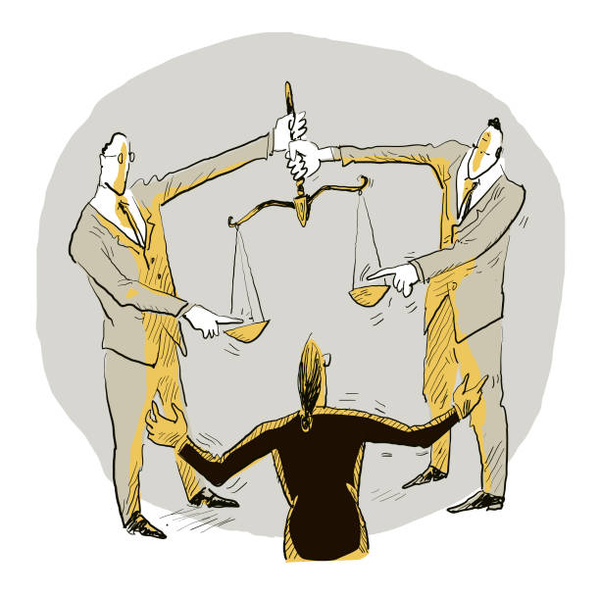
Gradual Reform
Below: Fitzroy Legal Service circa 1972
Source: Fitzroy Legal Service
Annual Report 2022-2023
Left: Cover of a 1970s edition of Australian Women’s Weekly depicting a shopfront lawyer, working under the federal Australian Legal Aid Office scheme.
Source: Legal Aid NSW Annual Report 2009-2010
Source: iStock Photos

Slide 6
Culturally Competent and Trauma-Informed Practice
Source: Greg Newington, Sydney Morning Herald
26 June 2024
KEYNOTE ADDRESS: CAPUCHIN MONKEYS, HENRY VII, ROCK STARS AND LEGAL AID

Slide 7
The future of Legal Aid
Need for funding
Rising demand
A common goal

Slide 8
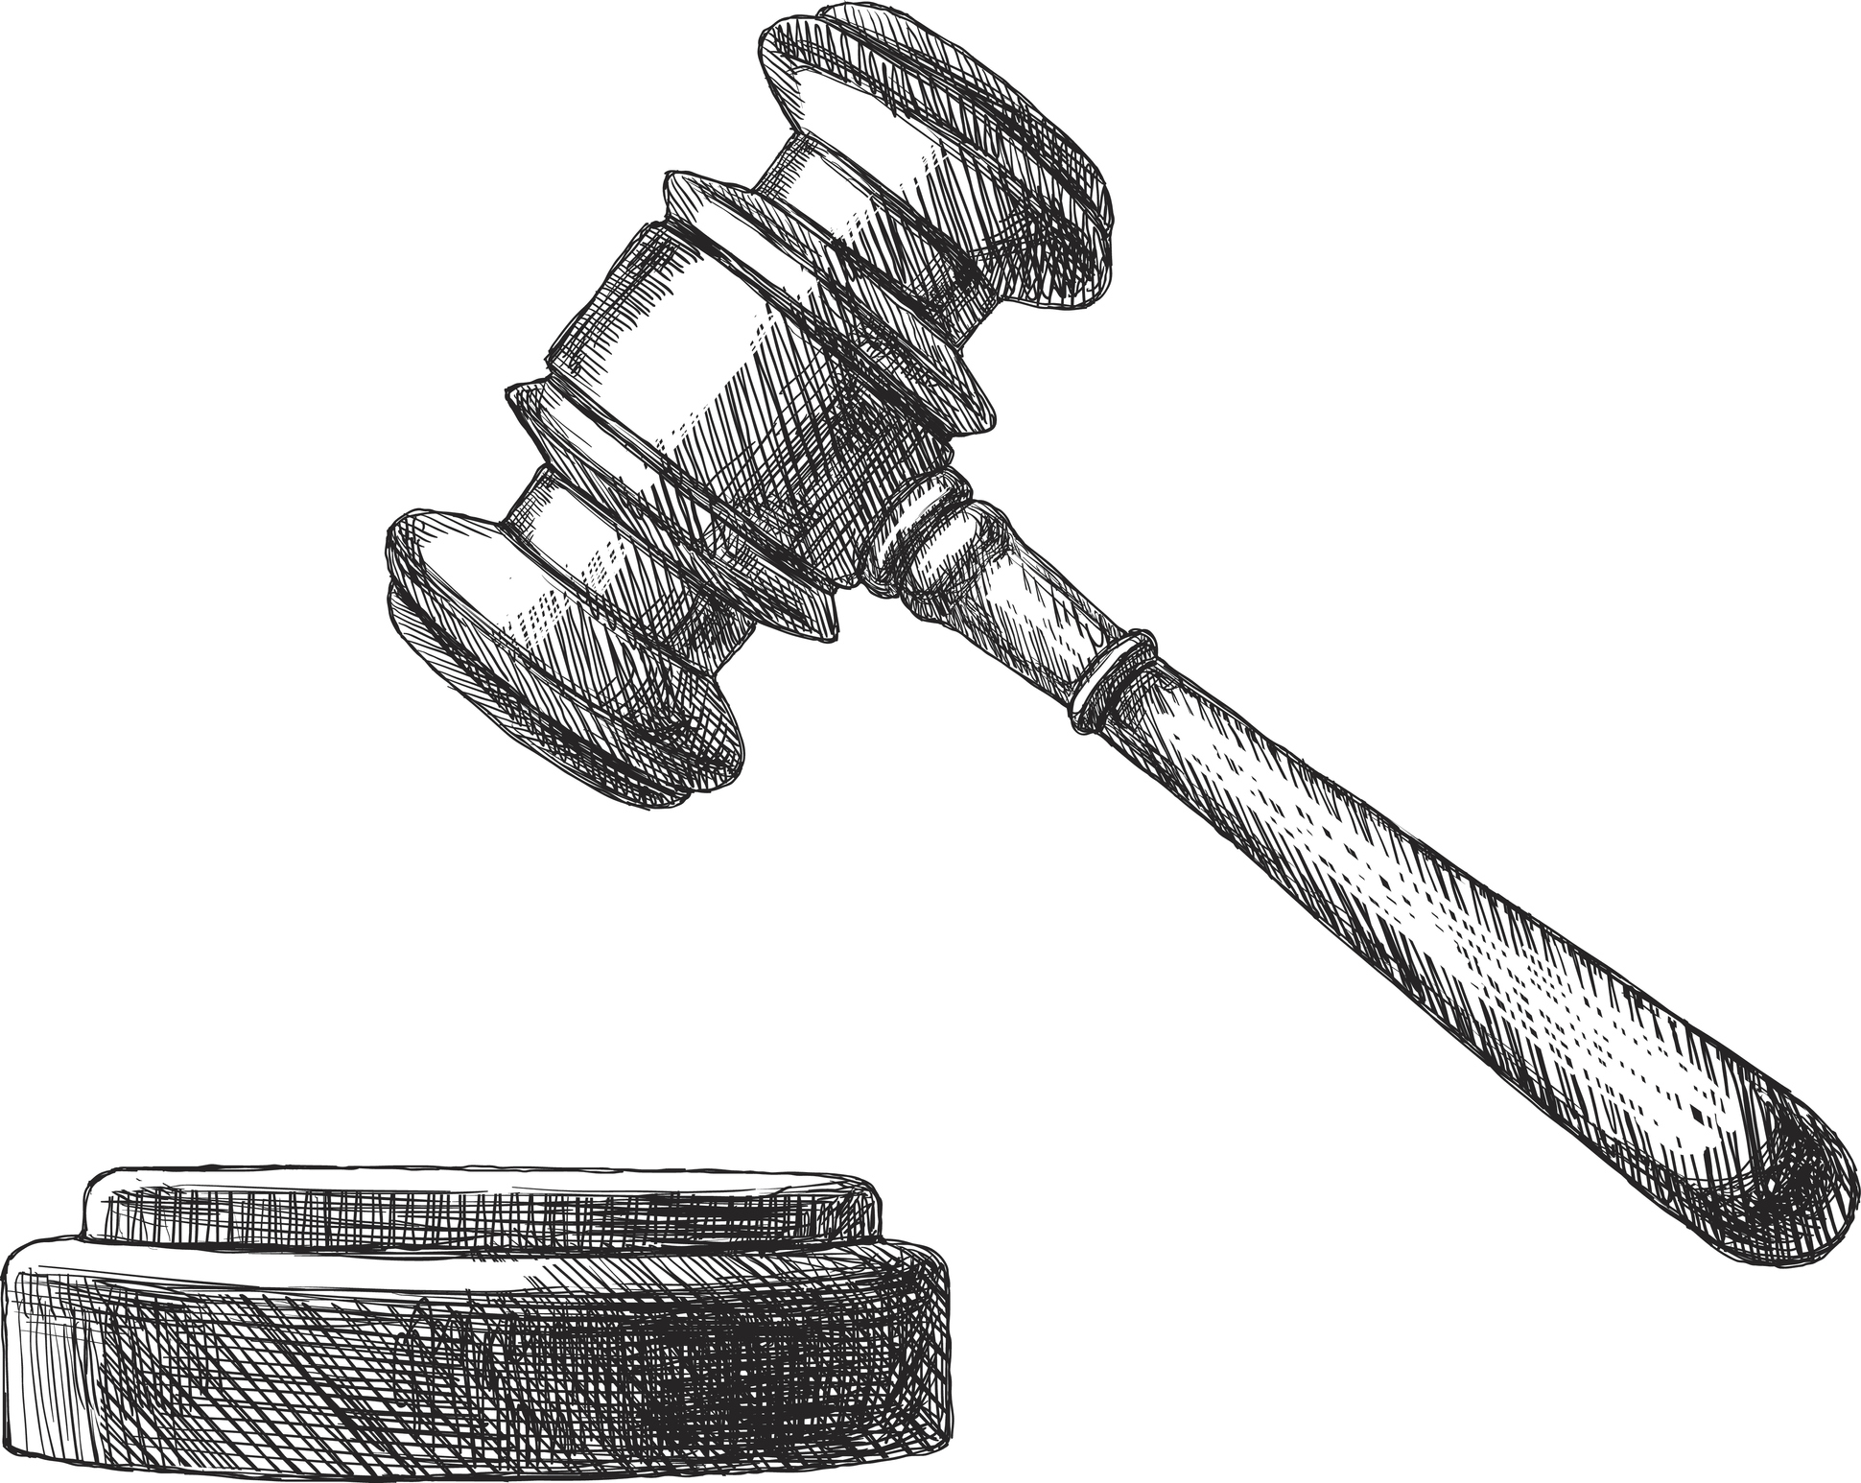
Connection between Legal Aid and the Judiciary
Source: iStock Photos

Slide 9
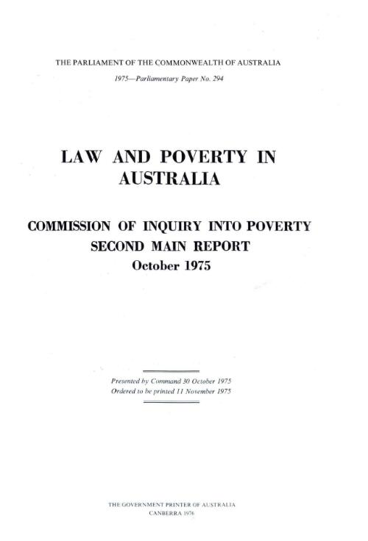
Access to Justice
The Honourable Ronald Sackville AO KC
Source: The Australian
The Sackville Report, 1975
Image source: National Library of Australia

Slide 10
Legal Aid in the High Court of Australia
Conviction appeals
BA v The King (2023) 275 CLR 128
Lane v The Queen (2018) 265 CLR 196
RP v The Queen (2016) 259 CLR 641
Cesan v The Queen; Mas Rivadavia v The Queen (2008) CLR 358
Azzopardi v The Queen (2001) 205 CLR 50
TKWJ v The Queen (2002) 212 CLR 124
Sentence appeals
The King v Hatahet [2024] HCA 23
Hurt v The King; Delzotto v The King [2024] HCA 8
Park v The Queen (2021) 273 CLR 303
Nguyen v The Queen (2016) 256 CLR 656
Green v The Queen (2011) 244 CLR 462
Marakarian v The Queen (2005) 228 CLR 357

Slide 11
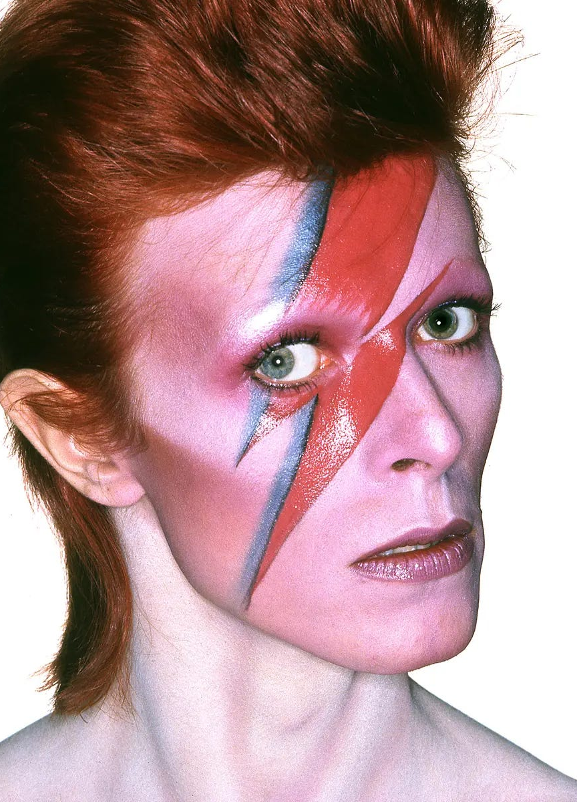
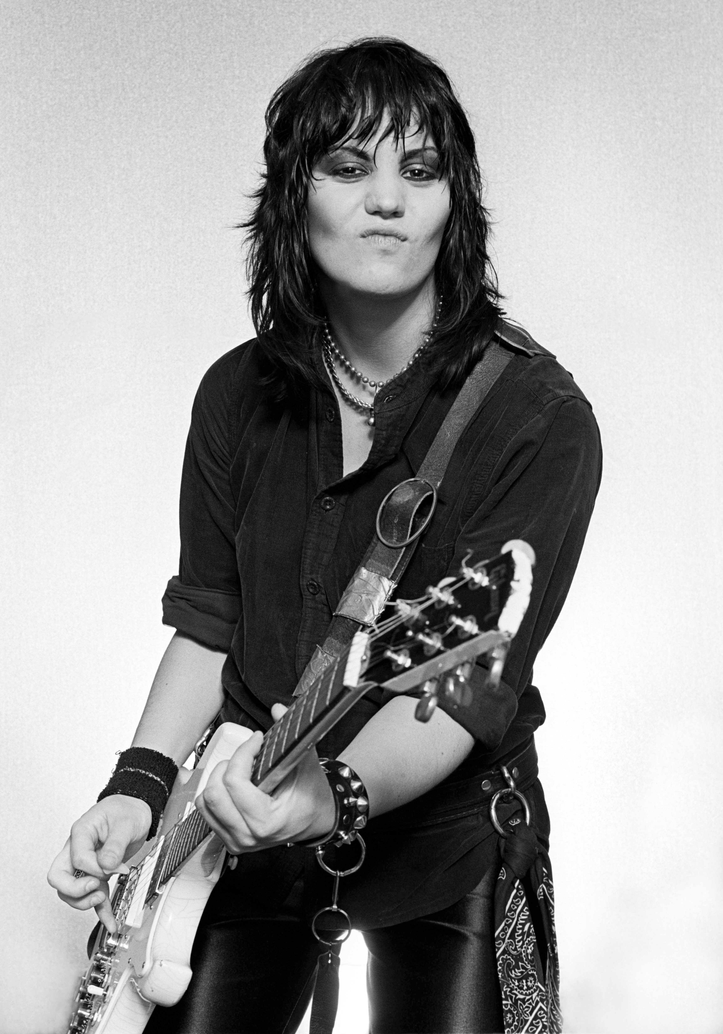
Role of the Criminal Defence Lawyer
Source: Duffy Archive & The David Bowie Archive
Source: Mark Weiss / Getty Images

Slide 12
Concluding Remarks

